Slide 1
ENGINEERING
Chemical Engineering
Module 5.3
Notes:
In the last session we explored some of the roles of an environmental engineer. In this session, we’ll explore chemical engineering. Chemical Engineers use maths, science (especially chemistry!) and problem solving skills to analyse, improve and create products that make our lives easier. They work in lots of different industries like: pharmaceuticals, manufacturing, health, water supply and petrochemicals.

Slide 2
Chemical Engineers
Laura and Wade discussing their chemical engineering careers
Video: https://www.youtube.com/watch?v=_UXwbxM8YfI
Image source:
http://myfootpath.com/careers/engineering-careers/chemical-engineer-careers/
Notes:
Video: Laura and Wade discussing their chemical engineering careers https://www.youtube.com/watch?v=_UXwbxM8YfI
Chemical engineers use chemistry to create solutions to some of the big problems we face. They are involved, in some way, in designing, manufacturing, analysing or improving most of the products we use today!
https://www.engineersaustralia.org.au/Communities-And-Groups/Colleges/Chemical

Slide 3
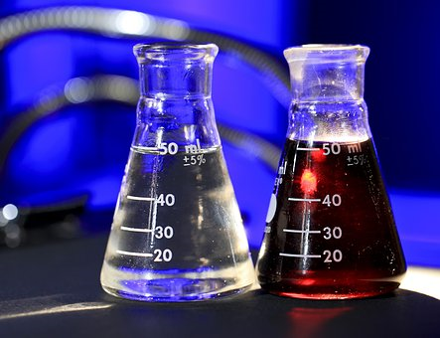
Chemical Engineering: Soap?
Image source: Pixabay.com
Notes:
Can you think of a product we use that a chemical engineer may have helped to make?
Some examples are:
Cleaning products
Beauty products
Safe drinking water
Heat/cold packs for sports injuries
Swimming pool chemicals
Medicines and vaccines
The bar of soap or the body wash you use in the shower or bath would have had a chemical engineer involved in its design and manufacturing! They would research and explore things like:
Which chemicals make the soap foam best?
Which chemicals are safe to be used on our skin?
Which chemicals get the dirt off easiest?
What sort of smell should the soap have and which chemical will give it that smell?
Which chemicals are safe to be washed down the sink?
These factors are probably things you wouldn’t have thought of before. There are lots of small details that a chemical engineer needs to think about when they are making new products.

Slide 4
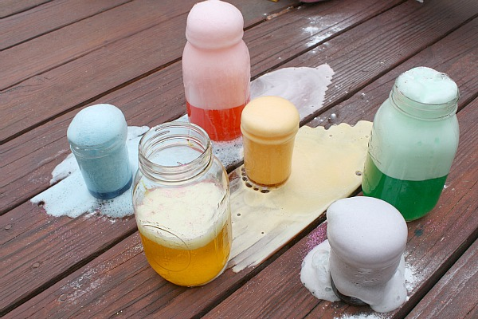
Acid + Base
Aim: To observe an acid base chemical reaction
Materials (Facilitator demonstration):
1 clear glass bottle / jar (wide top)
1 cup white vinegar
Food colouring
A mixing bowl
Washing-up liquid
Paper-towel
Rubber band
Bicarbonate of soda ( 3 tablespoons)
Large baking tray / tub
Procedure:
Stand the bottle / jar in the centre of the tray.
Mix the vinegar, a few drops of food colouring, and a squirt of washing up liquid together in the bowl.
Pour the mixture into the bottle.
Wrap the bicarbonate of soda in a small piece of paper-towel and secure with the rubber band.
Carefully place the bicarb soda package into the bottle.
Observe and document results.
Image source: https://buggyandbuddy.com/science-for-kids-chemical-reactions-using-baking-soda-and-vinegar/
Notes:
Let’s take a look at how an acid and base react when combined.
Refer to coordinator notes for Activity 5.3.1 and risk assessment for Module 5.
Discuss hypotheses with students before you begin. What do they think will happen?
Discuss what happened after the activity. Were hypotheses correct, or were they surprised?
Video Demonstration: https://youtu.be/tTP1LJl4BTk

Slide 5
What does the pH scale tell us?
Low numbers
STRONG ACIDS
1 | stomach acid
2 | lemon juice
3 | vinegar
4 | tomato
5 | black coffee
6 | milk
7 | pure water
8 | Human blood
9 | baking soda
10 | Antacid tablet
11 | ammonia
12 | bleach
13 | oven cleaner
14 | drain cleaner
pH = 7 NEUTRAL: neither acidic or basic
High numbers
STRONG BASES
Notes:
pH is the scale used to measure acidity, and stands for “power of hydrogen”. Neutral substances such as water have a pH of 7. A substance with a pH lower than 7 is acidic, one with a pH higher than this (up to 14) is a base (alkali).
The pH scale is between 0 and 14. It is a logarithmic scale; that means there is a 10 times change with each jump on the scale. For example, a substance with a pH of 6 is 10 times more acidic than water.
Indicators: Indicators are chemicals used to test whether a substance is an acid or a base. Litmus was the first indicator used to show pH. It produces a red colour for an acid, and a blue colour for a base. It’s range of colours is limited, so it can’t tell us the pH number of a substance. A special dye called a universal indicator produces a wide range of colours and is more accurate at telling us where a substance fits into the pH scale.
Fun facts:
Acids and bases can help neutralize each other.
Strong bases can be slippery and slimy feeling.
Acids taste sour, bases taste bitter.
Vitamin C is an acid called ascorbic acid.

Slide 6
H₂O Water Molecules!
H
H
O
1 oxygen atom + 2 hydrogen atoms = 1 water molecule
O
O
δ -
1 Hydrogen Ion + 1 Hydroxide Ion = 1 water molecule
H⁺
O
H⁻
H
H
O
Image source: SMART
H₂O
Notes:
The pH scale actually measures the concentration of hydrogen ions in a substance.
All chemicals are made up of molecules or atoms. When atoms group together, we call them molecules.
Some molecules are made up of just one type of atom. Others are made up of different types of atoms joined together, like water molecules, which have hydrogen and oxygen atoms.
An ion is a charged atom or molecule particle, and can be positive, or negative. If we break a water molecule up, we get two charged ions, a positive Hydrogen Ion and a negative Hydroxide Ion.
………………………………
Acids release positively charged hydrogen ions when they are dissolved in water. The strength of the acid depends on the number of hydrogen ions (H⁺) it can release.
Hydrogen ions are highly reactive and can eat away at other substances when they come into contact with them (we call this corrosion).
Bases react with acids to accept their hydrogen ions. The most reactive bases are called alkali’s. As alkali’s dissolve, they release hydroxide ions (OH⁻).
……………………………….
Extensions:
We can give chemicals shorter names by representing them with letters and numbers.
The chemical formula for water is H₂O. This means water is made from two hydrogens atoms (H) and one oxygen atom (O). ( H₂O → H⁺ + OH⁻ )
“HCl” is the chemical formula for hydrochloric acid. It breaks into positive hydrogen ions and negative chlorine ions. It is an acid because it releases positively charged particles of hydrogen. ( HCl → H⁺ + Cl⁻ )
“NaOH” is the formula for sodium hydroxide. It breaks into sodium ions and hydroxide ions. It is a base because it has a concentration of negatively charged hydroxide ions. ( NaOH → Na⁺ + OH⁻ )
Neutralisation: the chemical reaction between an acid and an alkali (or other base) is called neutralisation, because it results in products that are neither acid nor alkali. One of the products is always water, and the other a salt, made up of the left over ions.
Acid + base = salt + water
Hydrochloric acid + sodium hydroxide = sodium chloride + water
HCl + NaOH = NaCl + H₂O

Slide 7
pH Testing
Aim: To observe the pH of common liquids
Materials (per group):
8 plastic cups, 1 marker
30 ml lemon juice
30 ml white vinegar
30 ml brown vinegar
30 ml lemonade
30 ml Coca-Cola
30 ml water
30 ml milk
30 ml liquid soap
8 pH indicator test strips
Procedure:
Use the marker to label each plastic cup with a different liquid: lemon juice, white vinegar, water etc.
Add 30 ml of each liquid to the correspondingly labelled cups.
Dip a pH indicator strip into each one of the liquids, follow the instructions for the strip on how long to leave it in. Observe the colour change.
Compare the colour of the strip to the indicator chart to decide the approximate pH of the liquid.
Repeat for the other 7 liquids.
Notes:
Let’s take a look at the pH of different liquids. Which liquids have a low pH, close in number to the human stomach (pH 1.5 – 3.5?)
Refer to coordinator notes for Activity 5.3.2 and risk assessment for Module 5.
Discuss hypotheses with students before you begin. What do they think will happen?
Discuss what happened after the activity. Were hypotheses correct, or were they surprised?

Slide 8
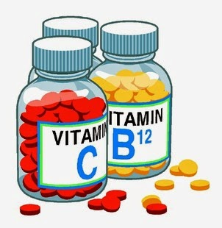
Chemical Engineering: Medicine?
Image source: Pixabay.com
Notes:
Chemical engineers are involved in the pharmaceuticals industry – that’s the industry where medicines are made!
Chemical engineers help to design and test how drugs are made, to ensure they work safely and effectively in our bodies to treat the desired medical condition. Some medicines have special coatings which have been developed by chemical engineers.
These coatings can affect how the drug reacts in our body – they can release the medicine quickly, or gradually over time.
To understand this better… lets first take a look into how our body digests things!
Vocabulary:
Pharmaceuticals – compounds manufactured for use as medicines

Slide 9
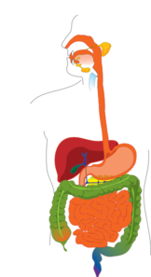
Our Digestive System
(pH 6.8) Mouth
Oesophagus
Stomach (pH 1.5 – 3.5)
Liver
Small Intestine (pH 6 – 7.4)
Pancreas
Large Intestine (pH 5.5 – 7)
Rectum
Appendix
Anus
Notes:
When we eat food, or take a tablet, it travels from our mouth, through our oesophagus, to our stomach. The muscles of our oesophagus contract in a wave like motion, to push food through the digestive system.
Special chemicals are released by our liver and pancreas to help break down food (and tablets). The stomach muscles contract to mix up the food before it moves through the small intestine, then the large intestine, through to the rectum and out the anus.
The pH in our digestive tract changes throughout the different organs. The pH of our digestive tract is generally acidic.
The mouth is only slightly off neutral (pH 7) where as the stomach is highly acidic at pH 1.3.
Did you know….
Hydrochloric acid (HCl), used in batteries and for refining metals, is actually released in our stomachs to help break down food and kill bad bacteria. That’s why the stomach has such a low pH!

Slide 10
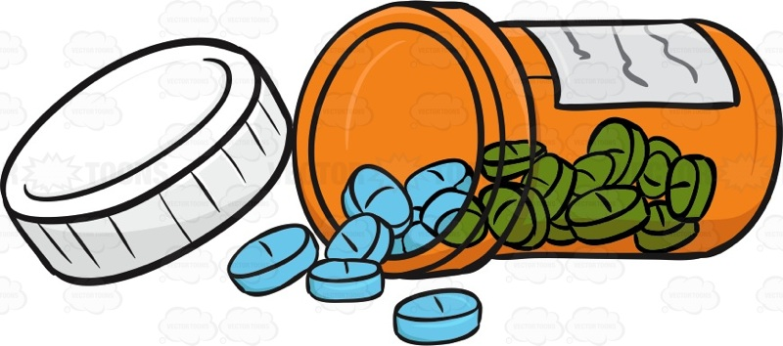
Tablet Coatings
ENTERIC COATINGS
Protect medicines from the acidic environment in our stomach, and protect our stomachs from the medicines.
MODIFIED RELEASE COATINGS
Help the drug release slowly and last longer, so we don’t have to take medicines so often.
Image source: Pixabay.com
Notes:
Acidic liquids like we find in our stomach can cause certain foods, and medicines, to break down quickly for fast absorption into our bodies. This can be a problem if the medicine will irritate our stomachs, or if the medicine needs to reach somewhere past the stomach in the digestive tract.
Tablet coatings are engineered to assist medicines to make it through the digestive system to where they need to be (and to make them nicer to swallow!).
Some drugs break down and don’t work properly if they are exposed to acidic conditions like the stomach.
Some drugs like Aspirin can irritate the stomach, even causing stomach ulcers.
Some drugs need to target digestive organs after the stomach like the intestines so they need to remain in tact through the acidic stomach.
Tablet coatings can also be engineered to make the smell, taste and colour of the medicine more appealing. Different coloured coatings also help us to tell the difference between multiple types of tablets.
There are 2 main types of tablet coatings:
Enteric coatings are tablet coatings which don’t break down in very acidic environments like the stomach.
Modified release coatings are coatings which break down slowly so that the medicine absorbs into the body very slowly. This means the medicine doesn’t have to be taken as often.

Slide 11
Tablet Coating Challenge!
A new drug has been designed to treat a disease harming the small intestine. Hooray!
The Problem:
The clinical trials so far show that the new drug breaks down in the acidic environment of the stomach, so it never reaches the small intestine to help patients.
Your Mission:
You and your team of chemical engineers and gastroenterologists (doctors of the digestive organs!) have been asked to experiment with different tablet coatings, to find a coating which will allow the drug to reach the small intestine.
Notes:
Vocabulary
Gastroenterologist: A doctor who specialises in the digestive organs including digestion, absorption of nutrients, diseases of these organs and the removal of waste.

Slide 12
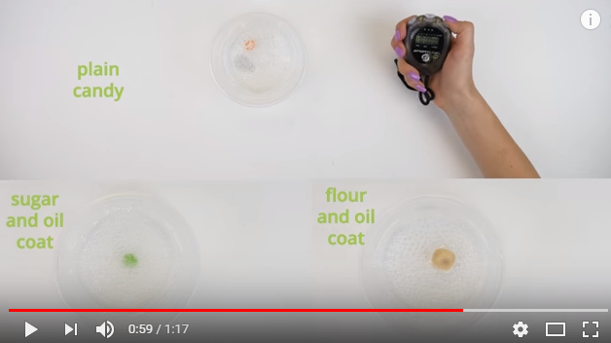
Video demonstration: https://youtu.be/wzitxKO1IEE
Notes:
Video demonstration:
https://youtu.be/wzitxKO1IEE
https://www.teachengineering.org/activities/view/cub_biomed_lesson05_activity1

Slide 13
Engineering Process
Image Source: http://www.sciencebuddies.org/engineering-design-process/engineering-design-process-steps.shtml#theengineeringdesignprocess
Notes:
Engineering is all about problem solving!
The Engineering Design Process outlines the steps in this process.
The problem: tablet coatings are needed to help get drugs to their target location.
Research: We have tested which liquids have similar pH levels to our stomachs (lemon juice/ lemonade).
Design requirements: last for 5 minutes in a stomach environment. Coating to be no more than 5 millimetres thick.
Now we need to design solutions, test them, and fine tune them!

Slide 14
Rules
Your tablet coating needs to withstand the stomach solution for 5 minutes.
Coating effectiveness will be judged based on the colour of the stomach fluid after 5 minutes. If the fluid is still clear, and the lolly has kept its colour, the coating has worked!
If the coating is still intact after 5 minutes it will be put to the test with 2 minutes of stirring!
Tablet coating can be no more than 5 mm thick. Thinner coatings will get more points.
Notes:
In the real world, tablet coatings need to be as thin as possible to make it easy for people to swallow them. Giant size tablets would be very hard to swallow! The same rule applies here - although of course no one is actually swallowing these ‘tablets’!!
Encourage teams to record their recipes between trials, so they can fine tune and modify to find improved solutions each time.
Trial runs and final testing are used so students experience the refining and evaluation aspect of being an engineer.

Slide 15
Materials
Skittles
3 plastic cups for testing
Lemon juice and lemonade solution (“stomach environment”)
Stop watch / timer
Paper plate
Plastic soon
Ruler (or callipers)
Flour
Corn flour
Vegetable Oil
Sugar
Honey
Notes:
A worksheet has been included with this activity to help students remember and modify their ‘recipes’ based on what worked or did not work.
Discuss with the group the different properties of each ingredient. Oil helps the dry ingredients stick together, helps make the mixture less sticky, and makes the coating less soluble (less dissolvable – remember, oil does not mix with water). Flour and corn flour are thickening agents with fairly similar properties. They also improve the workability of the overall mixture. Sugar thickens the mixture to some extent and makes the texture grainier, but can also make it less soluble (less dissolvable) when used in the right proportion.

Slide 16
References
Challenge activity inspired by the ‘Protect that Pill’ activity at TeachEngineering.org. Copyright © 2008 TeachEngineering.org. Used with permission.
https://www.teachengineering.org/view_activity.php?url=collection/cub_/activities/ cub_biomed/cub_biomed_lesson05_activity1.xml
Chemical engineering
https://www.engineersaustralia.org.au/Communities-And-Groups/Colleges/Chemical
https://www.youtube.com/watch?v=_UXwbxM8YfI
Acid and Bases
Video Demonstration: https://youtu.be/tTP1LJl4BTk
https://www.visionlearning.com/en/library/Chemistry/1/Acids-and-Bases/58
http://www.chem4kids.com/files/react_acidbase.html
Digestive system
http://www.gesa.org.au/resources/patients/the-gastrointestinal-gi-system/
http://patients.gi.org/what-is-a-gastroenterologist/

