Slide 1
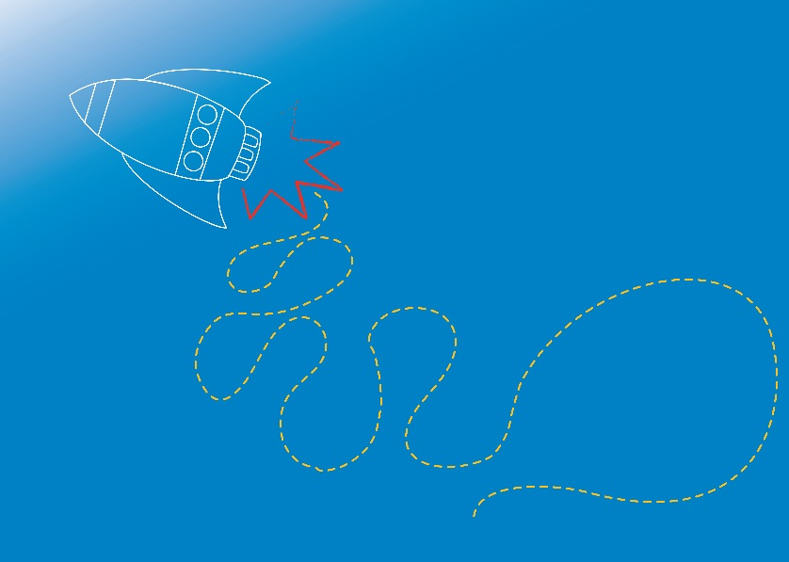
ELECTRONICS
Motors
Module 4.3
Notes:
In the previous sessions, we’ve explored harnessing power to turn on lights and make buzzers sound, and looked at how energy can be transformed into different types.
We’ve learned that energy flows through a circuit when the circuit is closed and unbroken, and switches are one way to stop or allow the flow of electrical current.
In this session, we’re going to look at two different types of electrical current that can flow through a circuit, and, we’re going to learn how to add a moving part to our circuits… has anyone heard of a motor?

Slide 2
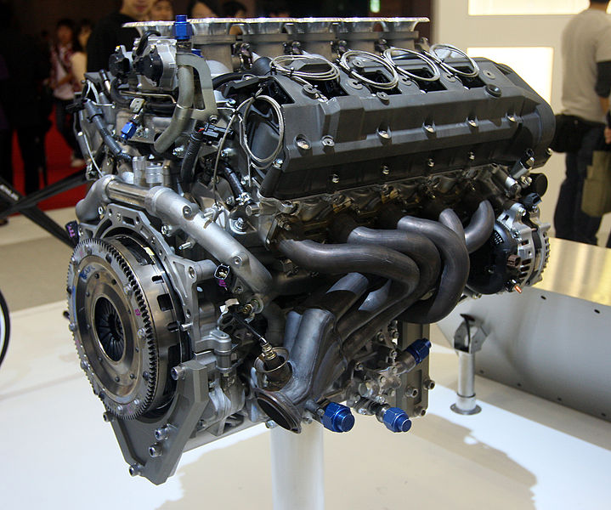
What is a Motor?
Image Source: www.pixabay.com
Notes:
* What is a motor?
Ask students for their ideas and suggestions.
Answer:
There are different types of motors!
An electric motor is a device that converts electrical energy into mechanical (kinetic) energy. Electric motors harness electrical power and transform this into movement, creating “motion”.
* Where can we find motors?
Ask students for their ideas and suggestions.
Examples: engines in cars, trains, motorcycles and other vehicles. Power windows, fans, air-conditioners, hair dryers. Home appliances (microwaves, refrigerators, washing machines), tools, toys (Tickle-Me-Elmo has a vibrating motor!), computers, fish tank filters…
* In parts of the world where electricity is unreliable or absent, and batteries are expensive, electronic devices like radios and lights can be powered by hand generators. A generator has the same parts as an electric motor, but works in reverse! Small generators inside devices can be turned / wound by hand cranks, allowing kinetic (movement energy) to be converted into electrical energy.

Slide 3
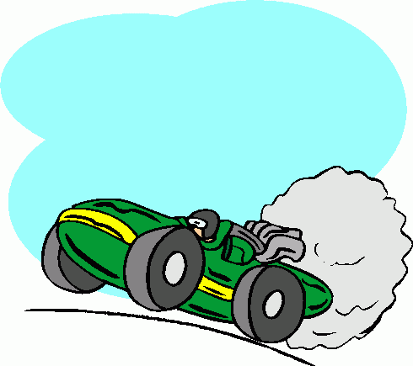
Motors and Magnets…
Image source: http://cliparts.co/car-engine-clip-art
Notes:
An electric current, and the forces in a magnetic field, can combine to create motion.
We know an electric current can flow through a battery. Let’s take a look at what happens when we add magnets to either end of a battery, and place the battery on some aluminium foil…
Refer to notes for Activity 4.3.2 Magnetic Car and Risk Assessment for Module 4.

Slide 4
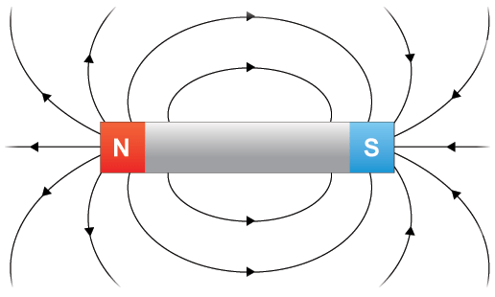
So… how do motors use magnets?
http://www.bbc.co.uk/bitesize/ks3/science/energy_electricity_forces/magnets_electric_effects/revision/3/
Notes:
How do motors use electricity and magnets to create movement?
To understand this, we need to understand a little more about magnets. Magnets produce a magnetic field, which attracts some materials, and can attract (pull towards) or repel (push away) other magnets.
We can’t see magnetic fields, but we can visualise them. We can use lines to represent magnetic fields around a magnet. These lines are called magnetic flux lines. The magnetic field is the area around the magnet where it’s magnetism can affect other materials. The closer the lines of force, the stronger the magnetic field.
The magnet in the diagram is a straight bar magnet, and has a north pole at one end and a south pole at the other. If we cut a bar magnet in half, we’d create two magnets, each with their own north and south poles! Magnets come in all kinds of shapes, even horseshoes. The circular magnets we used in the previous activity also had a north and a south pole.
An electric motor turns because of the forces of attraction and repulsion (push and pull) between a permanent magnet, and an electromagnet.
Permanent magnets: Some materials, including the metals iron, nickel, and cobalt, are “ferromagnetic”. These can be magnetized by an electric current, or by stroking another magnet. Once magnetised, these magnets stay magnetic, unless they become demagnetized by a shock, excess heat, or variable magnetic field.
Electromagnets: Magnets are not the only sources of magnetic fields. An electric current flowing through a conductor produces a circular magnetic field at right angles to the conductor. The current creates an electromagnet – a device that is extremely useful since its magnetism can be controlled and switched on and off. The poles of an electromagnet will be reversed if the direction of the current is reversed.

Slide 5
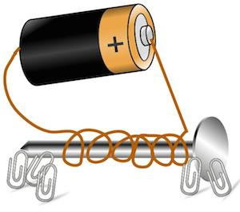
Electromagnets
Image source: https://study.com/academy/lesson/electromagnet-science-fair-project.html
Notes:
Let’s see if we can create an electromagnet using an electric current to magnetise an iron nail.
Refer to notes for Activity 4.3.3 Electromagnet and Risk Assessment for Module 4.

Slide 6
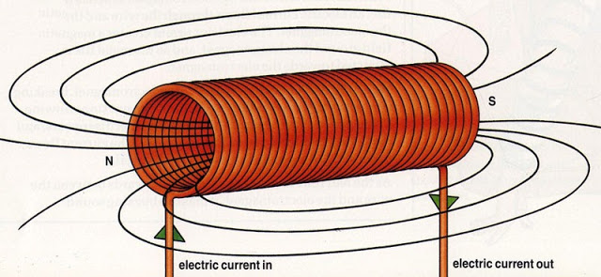
Fields and Forces
Notes:
We’ve seen how an electromagnet can be created using an electrical current.
So how does this relate to an electric motor?
Inside a motor, a wire coil sits between the opposite poles (north and south) of one or more permanent magnets. When an electric current is passed through the wire coil, it generates an electromagnetic field. This interacts with the magnetic field of the surrounding permanent magnets. Like poles are repelled, and unlike poles are attracted, which makes the wire coil rotate half a turn. The electric current is then reversed, to switch the wire coil’s magnetic poles, and the coil then moves another half-turn. Repeating this process makes the coil continuously spin around.
……………………………………
Extension:
When an electrical current is surrounded by magnets, the magnetic fields interact with the current, producing twisting / spinning force called torque. A scientist called Faraday discovered this effect and wrote a law about it called Faraday’s Law of Induction. Faraday's law of induction is a basic law of electromagnetism predicting how a magnetic field will interact with an electric circuit to produce an electromotive force (EMF) - a phenomenon called electromagnetic induction. Faraday’s law states that a changing magnetic field creates a voltage. The bigger the change in magnetic field strength and direction, the greater the voltage created.

Slide 7
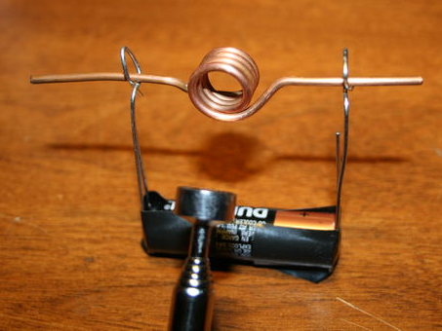
Simple Motor
Image source: SMART and http://www.instructables.com/id/Simple-DC-Motor/
Notes:
Let’s see if we can create a simple spinning motor using an electric current and a magnetic field.
Refer to Coordinator Notes for Activity 4.3.1 Simple Motor and risk assessment for Module 4.

Slide 8
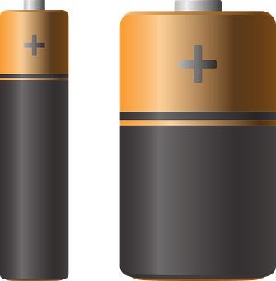
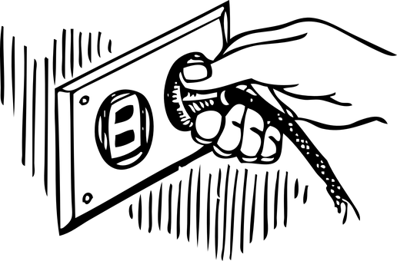
Types of Motors: AC and DC
Direct current (DC)
Alternating current (AC)
Image Source: www.pixabay.com
Notes:
There are two main types of motors and they are different due to the type of electricity they use. An AC motor uses alternating current. A DC motor uses direct current.
Direct current (DC): is usually produced by batteries, and it only flows one way around a circuit. For example, in a battery, the electricity travels from the negative end to the positive end. It never travels from the positive end to the negative end.
Alternating current (AC): can travel in two directions; forward and backwards. The direction of the flow of electricity in AC reverses dozens of times per second. Electricity outlets in our homes have alternating current (AC). Alternating current can be changed to a higher or lower voltage by a device called a transformer. High voltage from a power station needs to be transformed to a lower voltage for use in our homes.

Slide 9
Which is AC… which is DC?
Voltage (volts)
Voltage (volts)
Time (seconds)
Time (seconds)
Graph “1”
Graph “2”
Notes:
Alternating current and direct current can be drawn on graphs, and they look differently.
Which graph do students think represents the flow of AC, which one the flow of DC?
Remember, one type of current flows in a single direction, the other type constantly changes direction of current flow.
Answer: DC is on the left (the straight line), AC on the right (the alternating line).

Slide 10
Which is AC… which is DC?
Wire “1”
Wire “2”
Notes:
Which wire piece do students think represents the flow of AC, which one the flow of DC?
Remember, one type of current flows in a single direction, the other type constantly changes direction of current flow.
Answer: AC on the left (two directions of flow), DC on the right

Slide 11
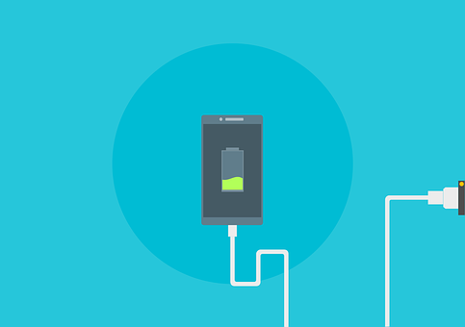
Alternating vs. Direct Current
Image Source: www.pixabay.com
Notes:
Both types of current, AC and DC, can provide energy to devices in order for them to work. So why do we have both?
DC is great for small scale devices, however it struggles to produce large amounts of energy. DC is used for anything that requires a battery.
AC is produced in power plants, and transported to our homes. It is much easier to transport over long distances, and easier to change from a high to low voltage using transformers. Transformers are electronic devices that can be used to change the voltages and current of AC.
Often both AC and DC are used together. For example, mobile phones use batteries. Mobile phone chargers have circuits inside which transform the AC from our home power points to DC, allowing us to safely charge the phone’s battery.

Slide 12
X-Racer Challenge
Notes:
In this week’s challenge, we are going to use our knowledge of motors to create a race car! Car’s will be raced at the end of the session!

Slide 13
X-Racer Challenge
Construct a race car using the materials provided!
Your team will be given a DC motor and a battery which will be your method for creating mechanical energy. How you choose to use that mechanical energy is up to you!
Take special care when constructing the vehicle.
Straight wheels, good placement of the motor, and the shape of the vehicle will each impact how fast it travels - and whether it goes in a straight line!
Notes:
You may choose to use just the DC powered motor to power your car. Or, you may come up with another idea to help move your car forward, using the materials provided.

Slide 14
https://youtu.be/UnxNe_XjlWg
Video: DC motor powered car with propeller
Notes:
Propellers are one way you could add power to your car!
4-wheeler with propeller: https://youtu.be/UnxNe_XjlWg
3-wheeler: https://youtu.be/36IEEvsEYVg
Rubber band power (instead of battery / DC motor)
https://www.youtube.com/watch?v=9xhEXDrMMLg
https://diy.org/rabinovitch/63115
https://www.youtube.com/watch?v=2ts7R__2gAE

Slide 15
Rules
Work in team of 2-4 people.
Each car can only use one DC motor and 1 battery.
You can use as many other materials as you like.
Your car needs to travel over the race track as quickly as possible. Times are calculated from when the car is released to when it has completely crossed the finish line.
Before the final race you can test your car. Your best time trial will contribute to your final score.

Slide 16
Materials
Plastic bottles & lids
Cardboard
Bottle lids
Rubber bands
Straws
Paper
Paddle pop sticks
Skewers
Toothpicks
Foam trays
Wire
Hot glue guns
Scissors
Sticky tape
Blue tack
9V battery
Battery clips
DC Motor

Slide 17
References
Electromagnets & Electric motors
https://science.howstuffworks.com/electromagnet.htm
https://www.bbc.co.uk/education/guides/zryj6sg/revision
https://www.livescience.com/53509-faradays-law-induction.html
https://study.com/academy/lesson/electromagnet-science-fair-project.html
https://www.britannica.com/science/Lorentz-force
http://www.physics4kids.com/files/elec_faraday.html
http://www.bbc.co.uk/schools/gcsebitesize/science/edexcel_pre_2011/electricityworld/thecostofelectricityrev1.shtml
http://www.rohm.com/web/global/electronics-basics/motors/what-is-a-motor/
http://www.instructables.com/id/Simple-DC-Motor/
https://electronics.howstuffworks.com/motor7.htm
AC/DC current
https://www.bbc.co.uk/education/guides/zddp34j/revision/3
https://learn.sparkfun.com/tutorials/alternating-current-ac-vs-direct-current-dc

