Slide 1
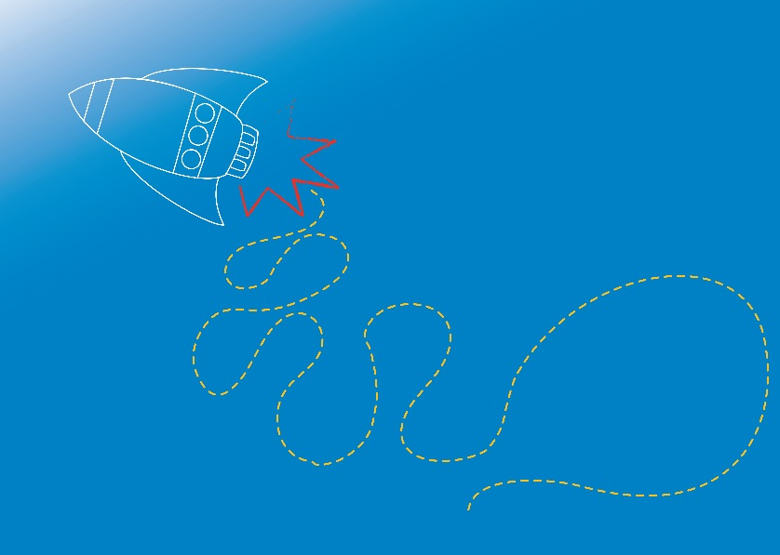
WEATHER
Wild Weather and Natural Disasters
Module 3.3

Slide 2
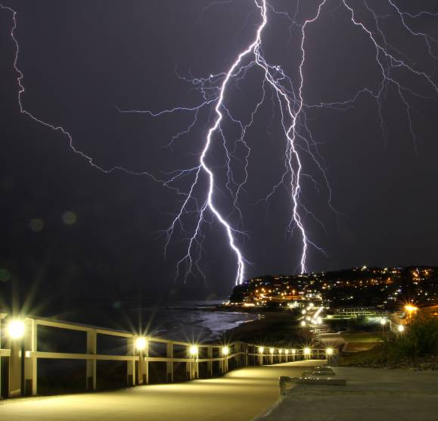
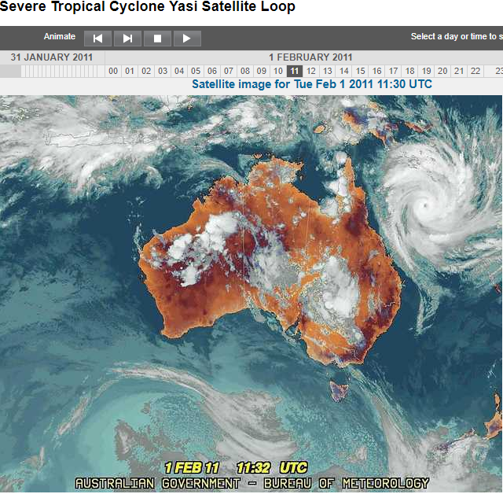
Wild Weather
Image sources: http://www.bom.gov.au/cyclone/history/yasi-satellite.shtml
http://www.theherald.com.au/story/3551445/lightning-camera-action-storm-chasers-cracking-shots/
Notes:
What kinds of wild weather have you heard of, seen in the news, or experienced?
What types of weather might we consider to be wild, severe or extreme?
Ideas: Big Waves, Strong Winds, Heat Waves, Cyclones, Hurricanes, Thunder Storms, Typhoons, Tornadoes, Waterspouts, Blizzards, Hail, Lightning….
Dramatic, wild weather events are natural processes and occur around the world every day. Their impact on humans and the environment can be quite extreme, so it is important to know what causes these events and how people can remain safe when faced with them. We don’t have all the answers about how and why dramatic weather events occur. Scientists and researchers study wild weather using a range of techniques including computer modelling and storm chasing!

Slide 3
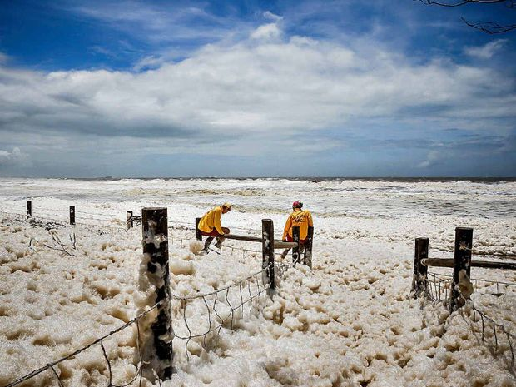
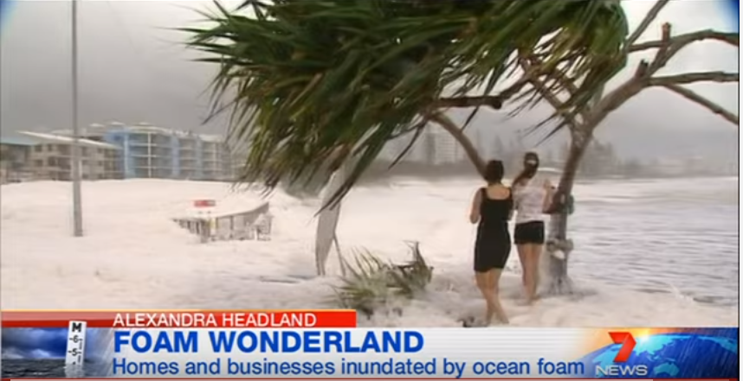
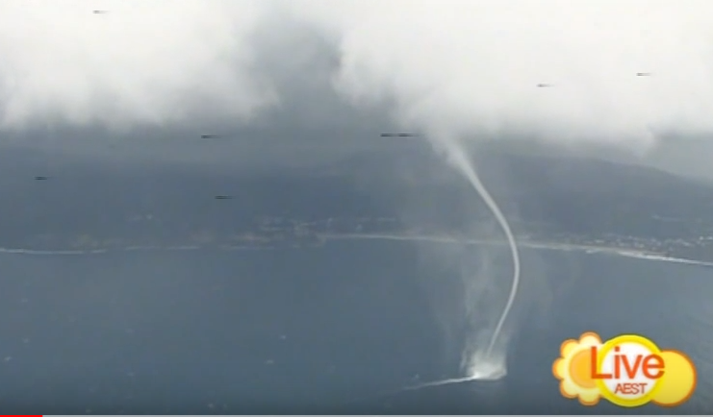
Wild Weather
https://www.youtube.com/watch?v=68RrXdy2d9I
https://www.youtube.com/watch?v=9Sw8HFgOwpI
Photographer Caillin Malley’s image of two surf lifesavers at Alexandra Headland’s beach in Queensland in late January 2013, following ex-tropical cyclone Oswald
Image source: https://www.sunshinecoastdaily.com.au/news/the-foam-rolls-out/1740733/
Notes:
In late January 2013, “wild weather” in the Australian state of Queensland led to the small towns of Alexandra Headland and Mooloolaba becoming covered in foam whipped up by heavy rain, strong wind and rough seas, following ex-tropical cyclone Oswald. Residents and visitors could be seen playing in the foam and taking pictures of the unusual phenomenon on the Sunshine Coast. Residents were advised not to play in the foam in case it contained pollutants and toxins from sewage. The foam was smelly and brown!
Foam Videos:
https://www.youtube.com/watch?v=68RrXdy2d9I
https://www.sunshinecoastdaily.com.au/news/foam-frenzy-may-hide-toxic-sewage/1734706/
News story: https://www.sunshinecoastdaily.com.au/news/the-foam-rolls-out/1740733/
……………………………….
Water Spout Video: Published on May 29, 2011 https://www.youtube.com/watch?v=9Sw8HFgOwpI
Amazing pictures of a waterspout captured live by the 7 News chopper off Sydney's coast. Reported live on The Morning Show. Amazing pictures. Just off Avoca.

Slide 4
Tornado Tube
Aim: To observe the shape of a tornado using two bottles.
Materials (per group):
2 x 1.25L clear recycled plastic bottles
1L room temperature water
1 x tornado tube valve
Food colouring (optional)
Glitter (optional)
Procedure:
Form into groups and collect materials.
Fill one of the bottles with water. You may also like to add food colouring and glitter, these are optional and do not change the experiment result!
Connect the tornado tube valve to the bottle with water, and then connect the empty bottle to the other end of the valve.
Flip the bottles over, so the water filled bottle is now on top of the empty bottle. Observe.
Repeat the experiment, this time give the bottles a swirl in a circle. Observe and document your results!
Extension: How quickly does the water drain from the top bottle to the bottom? Does swirling the bottles change the draining speed?
Notes:
Can we create a tornado?
Refer to the Module 3 Risk Assessment before undertaking the experiment.
Refer to coordinators notes for Experiment E3.3.1.
Encourage students to form a hypothesis prior to conducting the experiment about what might happen. Discuss observations and results and compare to hypotheses after the experiment.

Slide 5
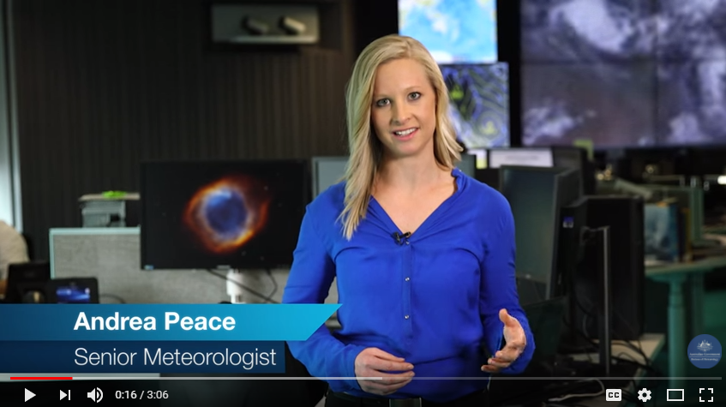
Tropical Cyclones
Video: https://youtu.be/5lKhb5Ggd-4
Australian Bureau of Meteorology, Understanding Tropical Cyclones
Notes:
Tropical Cyclones are dangerous because they produce destructive winds, heavy rainfall with flooding and damaging storm surges that can cause inundation of low-lying coastal areas.
Tropical Cyclones are low pressure systems that form over warm tropical waters (26.5 degrees or more) and have gale force winds (sustained winds of 63 km/h or greater and gusts in excess of 90 km/h) near the centre.
Reference: http://www.bom.gov.au/cyclone/index.shtml
In the USA cyclones are called hurricanes and in Asia they are called typhoons.
……………………………………..
Extension:
How do cyclones form? Warm damp air rises above warm ocean waters. When parcels of air move upwards, the pressure and temperature decrease forming clouds and rain. Strong winds also form. Because the earth is rotating, the strong winds blow in a circular motion as they are sucked upwards. The spinning system has very strong winds in the middle with a calm centre ‘eye’. The eye walls have the strongest winds. Cyclones need warm damp air to keep their power so they are found mostly around the equator. They also lose their power when they travel over land.

Slide 6
Australian Cyclone Categories
Category | Strongest gust (km/hr) | Typical effects
1 - Tropical Cyclone | Less than 125 km/hr Gales | Minimal house damage. Damage to some crops, trees and caravans. Boats may drag moorings.
2 - Tropical Cyclone | 125 - 164 km/hr Destructive winds | Minor house damage. Significant damage to signs, trees and caravans. Heavy damage to some crops. Risk of power failure. Small boats may break moorings.
3 - Severe Tropical Cyclone | 165 - 224 km/hr Very destructive winds | Some roof and structural damage. Some caravans destroyed. Power failure likely.
4 - Severe Tropical Cyclone | 225 - 279 km/hr Very destructive winds | Significant roof and structural damage. Many caravans destroyed and blown away. Dangerous airborne debris. Widespread power failures.
5 - Severe Tropical Cyclone | More than 280 km/hr Extremely destructive winds | Extremely dangerous, widespread damage and power failure.
Notes:
Cyclones are ranked on a scale of 1 to 5 according to the destruction they are expected to produce, where 5 is the most destructive.
Australia’s cyclone season runs from the November through to the May the following year, although cyclones outside of cyclone season are not unheard of.
Cyclone Yasi occurred in Queensland in 2011, and was the worst cyclone in Australia since 1918. 1450 km in diameter, this category 5 cyclone caused wide spread flooding and destruction across Northern QLD. The damage bill was estimated at $3.6 billion. http://www.nprsr.qld.gov.au/managing/cyclone-yasi.html

Slide 7
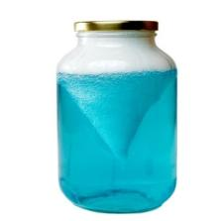
Tornado Jar
Aim: To observe the shape of a tornado using a jar.
Materials (per group):
1 clear jam jar / container with a screw on lid
Water
Washing-up liquid or liquid soap
Food colouring
Procedure:
Form into groups and collect materials.
Almost fill up the jar with water, leaving a small 1 cm – 2 cm gap, and add a few drops of food colouring.
Add a few drops of the washing-up liquid to the coloured water.
Tightly screw on the lid.
Swirl the container around in a circle a few times, then stop. Place the jar on a table.
Observe and document your results!
Image source: https://www.metoffice.gov.uk/learning/weather-for-kids/experiments/tornado
Notes:
Can we create a tornado?
Refer to the Module 3 Risk Assessment before undertaking the experiment.
Refer to coordinators notes for Experiment E3.3.2.
Encourage students to form a hypothesis prior to conducting the experiment about what might happen. Discuss observations and results and compare to hypotheses after the experiment.
Video Link to experiment:
https://youtu.be/cU7jUx5Mvx0

Slide 8
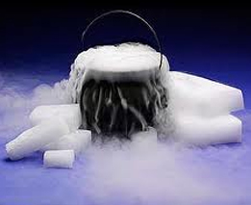
Demo: Cyclone in a Box
DRY ICE?
Dry ice is actually frozen carbon dioxide, the gas we breathe out.
Dry ice very cold (–78.5 °C) and burns your skin if you touch it. We need to use safety gear when handling.
Dry ice gets its name because when it ‘melts’ it doesn’t turn into a liquid like normal ice, it turns straight back into carbon dioxide gas.
It skips the liquid state altogether, and goes from solid to gas. This is called sublimation!
The fog you see around dry ice, is actually water vapour and carbon dioxide gas.
Image source: http://arcticdryiceinc.com/
Notes:
This demonstration helps students to visualise how warm rising air and a spinning earth create the circling winds of a cyclone.
Make sure you explain each step as you go, so the students are involved in the whole process.
Compare normal ice and dry ice, discuss differences with students. Remind students that things normally change from a solid to a liquid to a gas. Dry ice misses the liquid stage, and changes straight from a solid to a gas. This change from a solid directly to a gas is called sublimation.

Slide 9
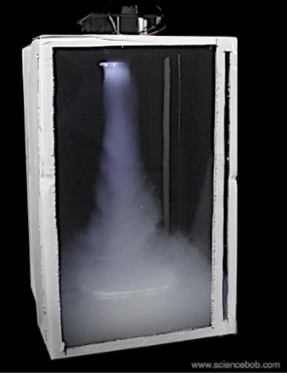
Demo: Cyclone in a Box
Facilitator Demonstration
Aim: To observe the formation and shape of a cyclone!
Materials:
Dry Ice (Caution: refer to risk assessment!)
Bowl/tray
Warm water
Tongs
Gloves (thick gardening gloves)
Safety glasses
Computer fan and 9V battery
Box constructed of cardboard and clear plastic
Refer to coordinator notes for procedure!
Image source: https://sciencebob.com/build-your-own-personal-fog-tornado/
Notes:
Refer to the Module 3 Risk Assessment before undertaking the experiment. Refer to coordinators notes for Experiment E3.3.3.
Encourage students to form a hypothesis prior to conducting the experiment about what might happen. Discuss observations and results and compare to hypotheses after the experiment.
Why is this a good demonstration of Cyclones?
The fog around the dry ice is mostly water vapour. When the fan is turned on, the water vapour gets sucked up toward the top of the box, spiralling because of where the air inlets are positioned and because of the spinning fan blades.

Slide 10
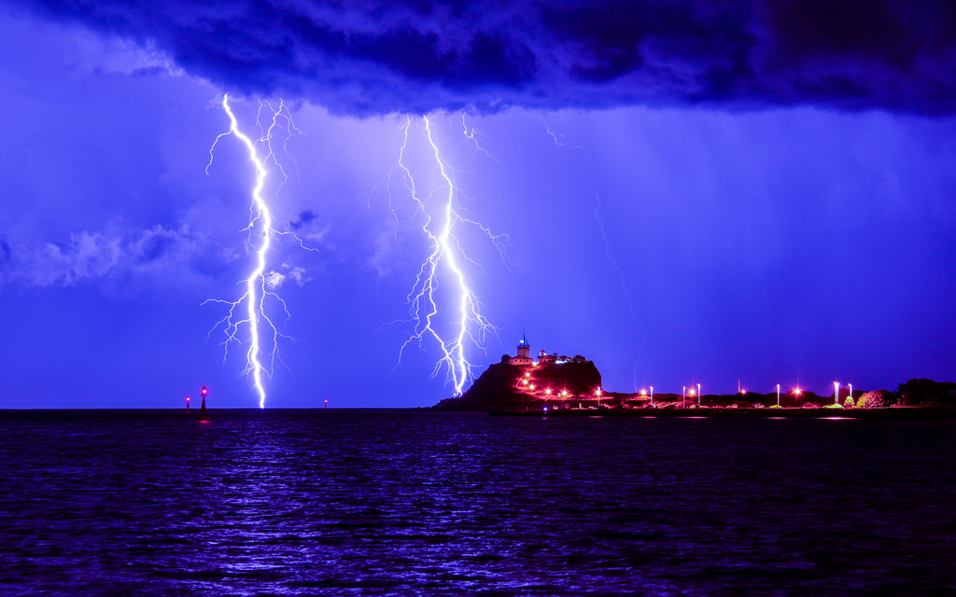
Thunderstorms and Lightning
Image Source: https://hiveminer.com/Tags/nobbys%2Cstorm
Notes:
Lightning is one of nature’s most spectacular displays - but it can also be spectacularly dangerous. It’s estimated that there are 5 -10 deaths per year from lightning strikes in Australia, and more than 100 serious injuries.
The simplest way of explaining lightning is that it is an electrical discharge that occurs within a cloud, between clouds, from clouds to the ground and even from the cloud top into the surrounding atmosphere.
What is thunder?
Thunder is the sound that accompanies lightning during a thunderstorm. Sounds simple enough, but why does lightning even make a sound? Any sound you hear is made up of vibrations. The vibrations travel as a sound wave through the air, until they reach your ear. Lightning is a huge discharge of electricity, and this electricity shoots through the air, causing vibrations to be formed in two ways:
1. The electricity passes through the air and causes air particles to vibrate. The vibrations are heard as sound.
2. The lightning is also very hot and heats up the air around it. Hot air expands, and in this case the air expands very quickly, pushing apart the air particles with force and creating more vibrations.
We see the lightning before we hear the thunder because light travels faster than sound. The light from the lightning travels to our eyes much quicker than the sound from the lightning. so we hear it later than we see it.
While we experience many thunderstorms in Australia, more intense thunderstorms are referred to as severe thunderstorms. These can cause significant damage by wind gusts, large hail, tornadoes or flash flooding. Thunderstorms which produce any of the following events are classified as severe in Australia: hail of 2 cm diameter or more, wind gusts of 90 km/h or more, tornadoes, heavy rainfall that could cause flash flooding.
References: http://media.bom.gov.au/social/blog/64/cooking-up-a-storm--how-thunderstorms-form/
http://www.sciencemadesimple.co.uk/curriculum-blogs/primary-blogs/thunder

Slide 11
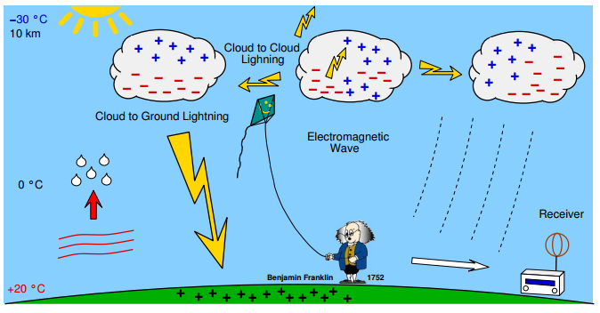
Lightning
Image Source: http://en.blitzortung.org/Compendium/Documentations/Documentation_2014-05-11_Red_PCB_10.4_PCB_12.3_PCB_13.1_PCB_14.1.pdf
Notes:
In 1972, Benjamin Franklin hypothesised that lighting was an electrical phenomenon. To test the theory, Benjamin flew a kite attached to a iron key, a silk ribbon, and a scientific device called a Leyden Jar, during a thunderstorm. The experiment successfully demonstrated that lighting was static electricity.
Different types of lightning:
Forked lightning is the shape we see when a bolt of lightning hits the ground.
Sheet lightning is the lightning that occurs within a cloud, lighting it up sheet-style.
There is no way meteorologists can forecast exactly when lightning will strike, or if it will be a cloud-to-ground strike or cloud-to-cloud, but we can predict thunderstorms. Every thunderstorm has lightning associated with it, so if thunderstorms are forecast there is a risk of lightning and you should consider seeking shelter.
There are many lightning detection and tracking systems across the world, which measure detect and analyse the radio waves produced by lightning strikes.
What can we do to stay safe when there is lightning about?
- stay inside and shelter well clear of windows, doors and skylights;
- don't use a landline telephone during a thunderstorm;
- avoid touching brick or concrete, or standing bare-footed on concrete or tiled floors; and
- keep checking the Bureau’s website or app and listen to your local radio station for storm warnings and updates.
References: http://media.bom.gov.au/social/blog/1478/a-bolt-from-the-blue-what-is-lightning/
http://www.gpats.com.au/lightning-detection-network

Slide 12
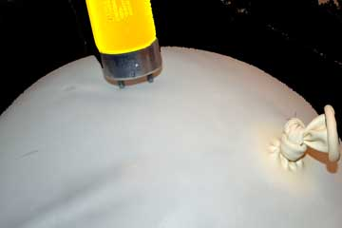
Static Power
Aim: To observe the power of static electricity
Materials (per group):
1 balloon
1 fluorescent light bulb (thin tube)
1 hairy head (or 1 woollen piece of clothing)
Procedure:
Form into groups and collect materials.
Blow up the balloon and tie off the end.
Darken the room / turn out the lights / pull down the blinds.
Charge up: rub the inflated balloon against your hair (or a woollen piece of clothing!) for 30 to 60 seconds.
Touch the metal prongs of the fluorescent light bulb to the balloon (being careful not to push too hard / pop the balloon).
Observe and document your results!
Extensions:
How long can you make the globe glow for?
What happens when you place the ‘charged up’ balloon near a small piece of tissue?
Image source: http://sciencewithkids.com/Experiments/Energy-Electricity-Experiments/Power-light-with-static-electricity.html
Notes:
Can we harness static electricity?
Refer to the Module 3 Risk Assessment before undertaking the experiment. Refer to coordinators notes for Experiment E3.3.4.
Encourage students to form a hypothesis prior to conducting the experiment about what might happen. Discuss observations and results and compare to hypotheses after the experiment.

Slide 13
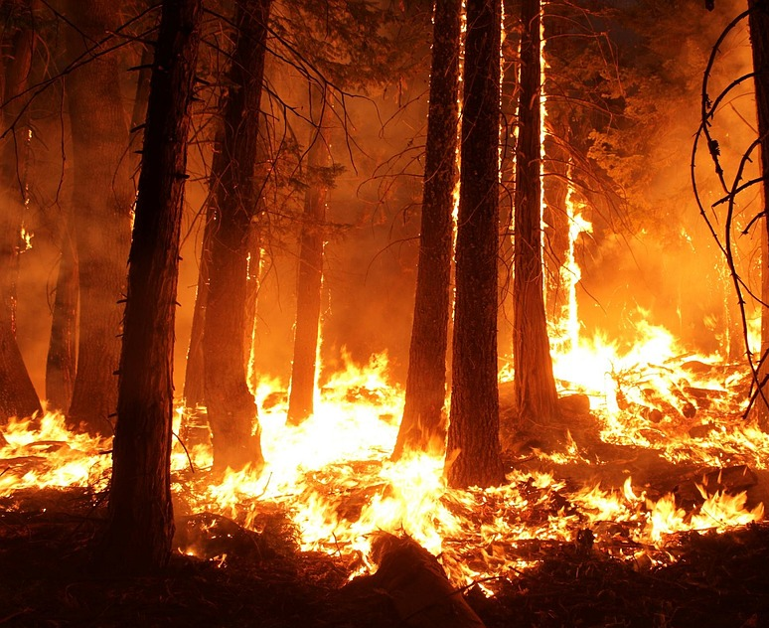
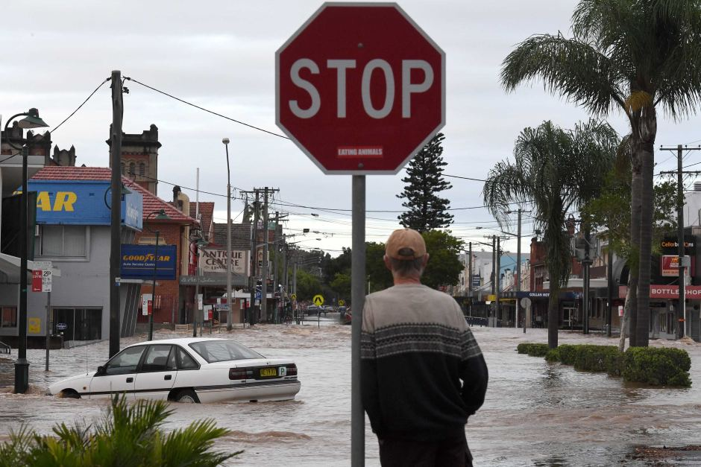
Wild Weather & Natural Disasters
Image sources: http://www.abc.net.au/news/2017-03-31/lismore-cbd-flooded/8404106 https://pixabay.com/en/wildfire-forest-fire-blaze-smoke-1105209/
Notes:
Australia experiences a range of 'natural disasters' including bushfires, floods, severe storms, earthquakes, droughts, heatwaves, and landslides. These events cause great financial hardship for individuals and communities, and can result in loss of life. Not all natural disasters are caused by weather, though some are closely linked (e.g. severe storms).
What kinds of natural disasters have you heard of, seen in the news, or experienced?
…………………………………………………
Bush Fires
Bushfires are different from controlled burning. Indigenous communities have traditionally used fire as a hunting and farming tool to assist with regeneration. Indigenous Australians used controlled burning and fire management is used to encourage the growth of new plants and to prevent the growth of long grass which contribute to the tinder or fuel for bushfires.
Fire management also allowed animals to escape, although some were lost to hunters. Eucalypts, for example, require occasional burns to regenerate. Fire stick farming used over tens of thousands of years created the fertile grazing plains west of the Blue Mountains. Long periods of dry, hot weather and natural vegetation that burns easily makes Australia particularly vulnerable to bushfire.
Australian bushfires can be particularly severe as eucalyptus trees contain large amounts of oil which can burn very fast and very hot. Other human management factors which have contributed to the severity of bushfires include high fuel loads, a change from fire prevention to fire fighting measures, and not building adequate buffer zones to protect built assets (Nairn Inquiry, 2003). As Australians learn to understand more about bushfires, bushfire prevention strategies are being adopted.
Reference: http://www.australia.gov.au/about-australia/australian-story/natural-disasters
Bush fire videos:
https://youtu.be/zUn7QFZdDBg
https://www.rfs.nsw.gov.au/resources/multimedia

Slide 14
Earthquakes & Tsunamis
Video: https://ed.ted.com/lessons/how-tsunamis-work-alex-gendler
Notes:
Earthquakes are a natural disaster – they are not formed by the weather. An earthquake (or quakes, tremors) is shaking of the surface of earth, caused by sudden movement in the Earth's crust. They can be extremely violent, or, cannot be felt by anyone. Earthquakes are usually quite brief, but may repeat. They are the result of a sudden release of energy in the Earth's crust.
Seismologists are scientists who study earthquakes. They use seismometers to measure and record activity in the earth.
The word Tsunami is a Japanese word meaning “great harbour wave”. A tsunami is a large ocean wave usually caused by an underwater earthquake, volcanic explosion or underwater landslide. Tsunamis are NOT tidal waves. Tidal waves are caused by the forces of the moon, sun, and planets upon the tides, as well as the wind as it moves over the water. Video: https://ed.ted.com/lessons/how-tsunamis-work-alex-gendler

Slide 15
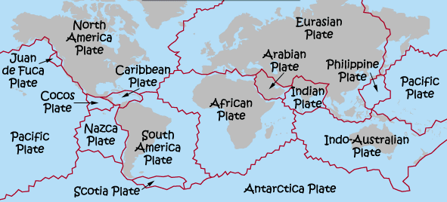
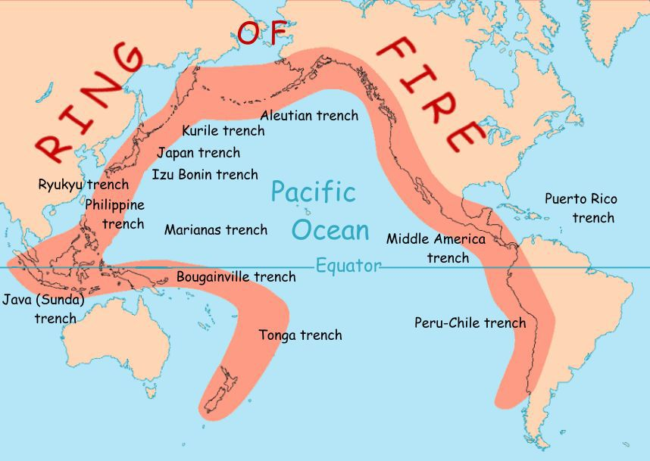
Tectonic Plates
Image sources: http://www.worldatlas.com/aatlas/infopage/tectonic.htm https://www.nationalgeographic.org/encyclopedia/ring-fire/
Notes:
The planet Earth’s outer shell, or crust, is made up of tectonic plates, which fit together a little like jigsaw puzzle pieces. The movement of these giant plates can cause earthquakes,. Most of the world’s earthquakes occur at the boundaries to these plates.
Australia sits in the middle of the Indo-Australian Plate, away from any plate boundaries. This is why earthquakes are not common in Australia, although they are possible. The tectonic plate that Australia sits on is being pushed by forces within the earth to the north-east, moving about 7 cm per year into the Pacific, Eurasian and Philippines plates. This movement causes pressure to build up in the Earth’s upper crust, and can cause earthquakes in Australia. 3 key types of “faults” between plates that result in earthquakes:
Strike – Slip: Plates move sideways against each other. California's ‘San Andreas Fault’ is an example of this.
Dip – Slip: Plates move up and down against each other.
Oblique: Plates move in both up and down and side to side motions.
………………………………….
Extensions:
A large portion of the world’s earthquakes happen at the “Pacific Ring of Fire”. Making countries like Japan, and the west coasts of North and South America very earthquake prone.
The Ring of Fire is a string of volcanoes and sites of seismic activity, or earthquakes, around the edges of the Pacific Ocean. Roughly 90% of all earthquakes occur along the Ring of Fire, and the ring is dotted with 75% of all active volcanoes on Earth.
The Ring of Fire isn’t quite a circular ring. It is shaped more like a 40,000-kilometer (25,000-mile) horseshoe.
Q: Tsunamis can also be caused when tectonic plates move – can anyone explain why Australia doesn’t often get big tsunamis? A: Australia is largely protected by smaller Pacific Islands, the Great Barrier Reef and the structure of the continental shelf. Though we can and do experience Tsunamis from time to time.

Slide 16
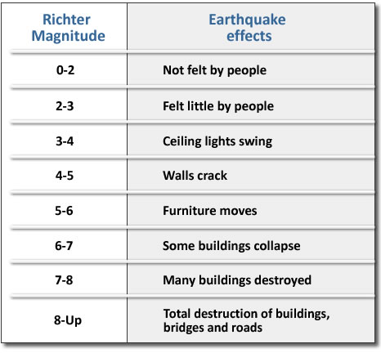
Richter Scale
Image source: http://www.sms-tsunami-warning.com/pages/seismology-measurement#.Vp2HCPl9670
Notes:
The Richter Scale is used by seismologists to ate the magnitude of an earthquake, that is the amount of energy released during an earthquake. Each point higher on the scale is a 10-fold ( 10 times bigger) increase in strength.
It was invented in 1935 by Charles F. Richter of the California Institute of Technology as a mathematical device to compare the size of earthquakes.

Slide 17
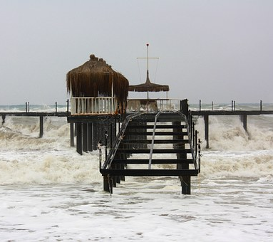
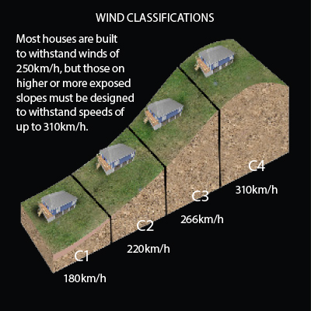
Designing for Wild Weather!
Image sources: www.pixabay.com http://www.australiangeographic.com.au/topics/science-environment/2016/02/how-to-cyclone-proof-your-house
Notes:
Australia has developed effective monitoring and warning systems, to detect when wild weather and natural disasters are approaching.
Our weather observation and forecasting systems provide engineers and scientists with information to assess which areas are most at risk, and how to best build homes, roads, and infrastructure such as water supply and power stations to withstand likely weather events.
In Australia, we have well planned building design codes and standards, to make sure homes, buildings, roads and other structures are built to withstand our wild weather. Different areas of Australia have different standards, depending on the weather that is found there and the position the building or structure will be built (e.g. on top of a hill or on the flat).

Slide 18
Disaster Proofing
Challenge!
Design and construct a building that can withstand some of the wild weather we face in Australia.
Design a structure to withstand:
Cyclonic winds
Flooding

Slide 19
Wind Proofing
The roof of a building is often the first thing to come off in strong winds. Having the roof on a 30 – 45° angle and securing it firmly to the frame of the house are simple ways to reduce damage.
A hip roof is more wind resistant than a high gable roof
Hip Roof
High Gable Roof
Notes:
http://www.dwf.org/en/content/ten-key-principles-cyclone-resistant-construction
http://www.unisdr.org/files/11711_CycloneArchitecture1.pdf

Slide 20
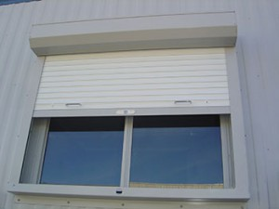
Wind Proofing
Windows and doors are also weak spots for wind damage. If wind enters the internal area of the house it causes much more strain on the structure and often ends up with severe damage.
To avoid this, shutters and other window coverings are often used.
Image source: http://www.perthhomeguard.com.au/super-cyclonic-shutter-series/

Slide 21
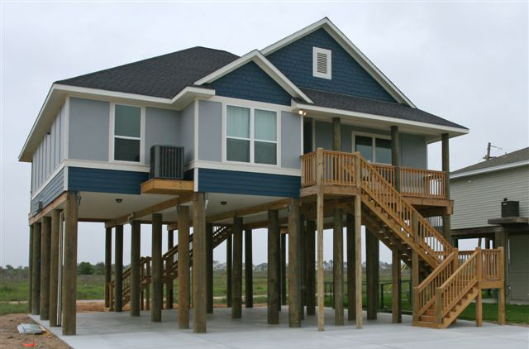
Wind Proofing
Sometimes buildings can be blown off the ground. To avoid this, the building needs to be secured to the ground with strong foundations.
This can be directly onto the ground or on piers or stilts.
Image source: http://www.buildingproductsplus.com/beach-home-materials/
Notes:
http://www.dwf.org/en/content/ten-key-principles-cyclone-resistant-construction
http://www.unisdr.org/files/11711_CycloneArchitecture1.pdf

Slide 22
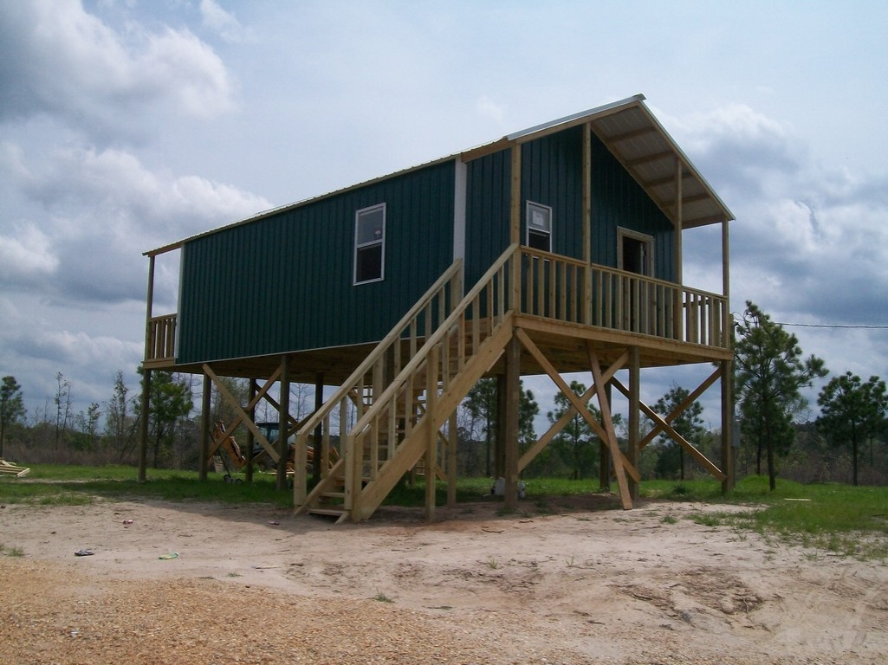
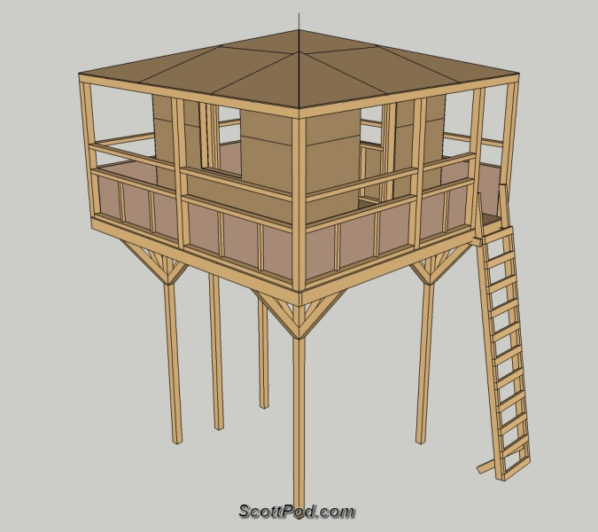
Flood Proofing
Houses and other buildings in flood-prone areas are sometimes built on stilts or built on raised land. Stilts need to be braced to ensure they are stable. Knee bracing is best when flooding occurs as it allows flood debris to flow past without dragging on the structure.
Diagonal Bracing
Knee Bracing
Image source: https://www.newhorse.com/profile/b.515.r.27711.u.54030f.html
http://www.scottpod.com/model_details/stilt_playhouse/stilt_playhouse_details.html

Slide 23
The Challenge
Design a disaster-proof building out of the materials provided.
You’ll be given a supply of non-recycled materials which cannot be restocked.
You can access as much recyclable material as you wish.
Your building must have a roof, four walls and at least one window and one door.
Your building must withstand two tests – the flood test and the cyclonic winds test.
Notes:
Students should work in groups of ~2 – 4.

Slide 24
References
http://www.dwf.org/en/content/ten-key-principles-cyclone-resistant-construction
http://www.unisdr.org/files/11711_CycloneArchitecture1.pdf
http://qldreconstruction.org.au/u/lib/cms2/planning-for-stronger-nq-part-2.pdf
http://www.bom.gov.au/cyclone/about/
http://www.australiangeographic.com.au/topics/science-environment/2011/02/australias-worst-cyclones-timeline/
http://www.disaster.qld.gov.au/disaster-resources/documents/storm-tide-handbook.pdf
http://news.nationalgeographic.com/news/2014/01/140115-earthquakes-california-faults-science/
http://www.australiangeographic.com.au/topics/science-environment/2011/10/earthquakes-in-australia/
https://www.youtube.com/watch?v=68RrXdy2d9I
https://www.sunshinecoastdaily.com.au/news/foam-frenzy-may-hide-toxic-sewage/1734706/
https://www.sunshinecoastdaily.com.au/news/the-foam-rolls-out/1740733/
https://www.youtube.com/watch?v=9Sw8HFgOwpI
http://www.bom.gov.au/cyclone/history/yasi-satellite.shtml
http://www.theherald.com.au/story/3551445/lightning-camera-action-storm-chasers-cracking-shots/

Slide 25
References
http://www.bom.gov.au/cyclone/index.shtml
http://www.nprsr.qld.gov.au/managing/cyclone-yasi.html
http://media.bom.gov.au/social/blog/64/cooking-up-a-storm--how-thunderstorms-form/
http://www.sciencemadesimple.co.uk/curriculum-blogs/primary-blogs/thunder
http://media.bom.gov.au/social/blog/1478/a-bolt-from-the-blue-what-is-lightning/
http://www.gpats.com.au/lightning-detection-network
http://www.australia.gov.au/about-australia/australian-story/natural-disasters
https://youtu.be/zUn7QFZdDBg
https://www.rfs.nsw.gov.au/resources/multimedia
https://ed.ted.com/lessons/how-tsunamis-work-alex-gendler
http://www.sms-tsunami-warning.com/pages/seismology-measurement#.Vp2HCPl9670
http://www.worldatlas.com/aatlas/infopage/tectonic.htm
http://easyscienceforkids.com/all-about-earthquakes/

