Slide 1
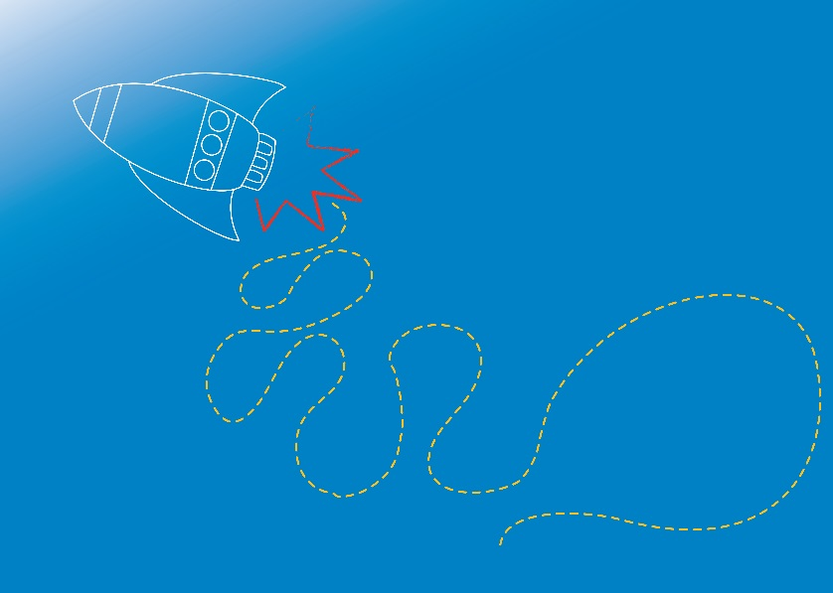


WATER
Water Filtration
Module 2.2

Slide 2
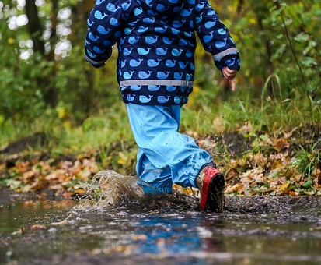
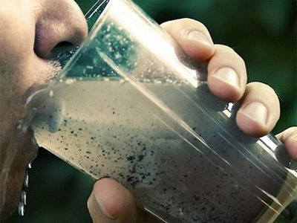
Can we drink water from everywhere we find it?
Image sources: www.haikudeck.com www.pixabay.com
Notes:
Ask students if we can drink water from everywhere we find it (puddles, creeks, drains, taps, dams)
Ask where they think safe drinking water comes from?
Examples: home and school taps, water bubblers.
Ask students what they think might be in dirty water, that they shouldn’t drink?
Water can be contaminated with lots of different things! We can’t always see contamination.
Examples:
Dirt and grit
Bacteria, viruses, parasites and other bugs
Chemical pollution
Poisons
Animal and human waste
Even if water looks clear and clean, it could be actually be dirty!
Drinking contaminated water can cause illness.
Facts: Sadly, 3.4 million people across the world die from water related diseases every year (World Health Organisation, 2009). This is because dirty water can carry microorganisms, some of which can cause disease and make us sick. We call the bugs that make us sick pathogens. These are so tiny you need a microscope to see them.
In countries where there isn’t clean drinking water, diseases like cholera, malaria and severe diarrhoea are very common.

Slide 3
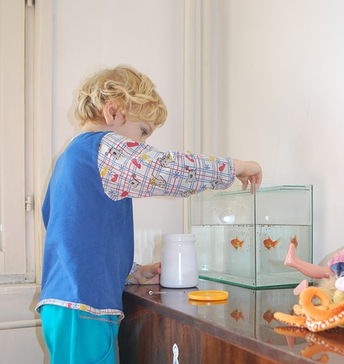
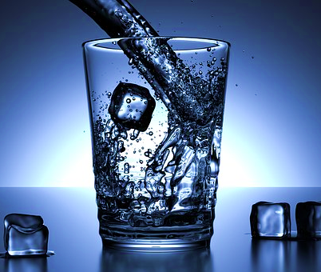
How do we get clean water?
Image source: http://www.pixabay.com/
Notes:
783 million people don’t have access to clean water. That’s 1 in every 9 people! And more than 32 times the population of Australia!
Ask students how they think clean drinking water is supplied to our taps? Where does our water come from?
Surface sources include: rivers, dams, lakes, rain
Underground sources include: ground water, sand beds.
How do we keep the water clean in a fish tank? (plants, filters, chemicals)
Luckily, we don’t normally have to clean our own drinking water!
Water Treatment Plants are used to produce safe drinking water, before the water enters our pipes and comes through to our taps.
Drinking water is treated through a multiple step process to make it ‘potable’ (safe to drink). These steps can include: Coagulation, Flocculation, Sedimentation, Filtration, Disinfection, Fluoridation.
…………………………………
Extension:
A tour of a local water treatment plant would be a fantastic compliment to this lesson.

Slide 4
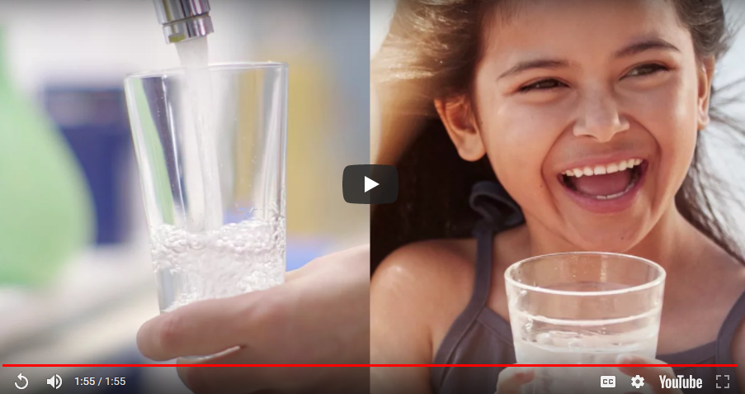
Water Treatment
Sydney Water Video: https://youtu.be/rz2DGOMN_n4
Image source: http://www.sydneywater.com.au/
Notes:
This short video explains how Sydney Water collect, store, treat, and deliver safe drinking water to the community. This is the same process as other towns, and other States across Australia.
Sydney Water video: https://youtu.be/rz2DGOMN_n4
http://www.sydneywater.com.au/SW/water-the-environment/how-we-manage-sydney-s-water/safe-drinking-water/index.htm

Slide 5
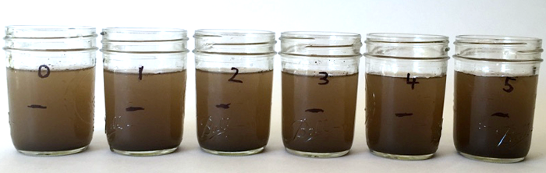
Can we clean muddy water?
Image source: https://www.sciencebuddies.org/
Notes:
Water can contain soil particles that make the water look murky and cloudy. Solids floating in water are called suspended solids.
How might we make a glass of muddy / dirty water clean?
Examples: filtering, chemicals.
We can wait for the solid particles to settle and sink, but this can take a long time. Bacteria and pathogens can stick to the particles, and make it unsafe to drink.
So we need to remove the particles!
The first steps in making muddy water clear and clean to drink are called coagulation and flocculation. In these steps, a chemical (coagulant) is added to the water to help the particles stick together into clumps to make them easier to remove. When particles stick together we call this coagulation. The clumps of coagulant combined with the particles is called ‘floc’. Flocculation is a gentle mixing, or stirring process, that helps the flocs continue to join together, to form into even bigger, denser clumps.
Let’s have a go!

Slide 6
Muddy Water
Aim: To observe a chemical process for cleaning muddy water
Materials (per group):
2 clear cups or jars
1 teaspoon of alum (aluminium sulphate)
2 spoons
Dirty water (2 spoonful's of soil plus 500ml water)
Marker
Procedure:
Form into groups of 2 to 3 students.
Mix the soil into the water.
Pour an equal amount of dirty water into each cup.
Use the marker to label 1 cup ‘Floc’ and the other ‘control’.
Add a teaspoon of alum to the cup marked ‘Floc’.
Stir both cups well for about two minutes. Observe both mixtures.
Stop stirring and wait 5 minutes.
Observe both mixtures again.
Notes:
Now we’re going to observe the processes called coagulation and flocculation, to see if we can make muddy water clear!
Coagulation: chemical reaction. Flocculation: stirring and mixing.
Before performing the experiment, reinforce the Scientific Method by discussing with the students a hypothesis about what might happen. Then assist students to perform the experiment to confirm or disprove the hypothesis. Discuss what was observed (the results), and explore student ideas on why this may have happened.
This experiment explores coagulation and flocculation.
Refer to RISK ASSESSMENT for Module 2 before conducting experiment.
Refer to Experiment notes (E2.2.1 in Coordinator Notes for Module 2.2)
……………………………….

Slide 7
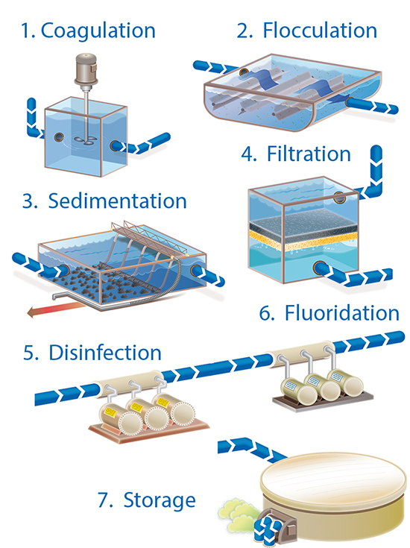
The 5 main steps to clean water!
Image source: https://www.sawater.com.au/community-and-environment/our-water-and-sewerage-systems/water-treatment/conventional-water-treatment-plants
Notes:
This slide is an opportunity to discuss the key water treatment processes with the participants. Water is typically stored in reservoirs and dams, then pumped to a treatment plant for cleaning. Before it enters the plant, the water will through a grates to catch and remove big sticks and rubbish.
Step 1 COAGULATION
A chemical (coagulant) is added to the untreated water. It reacts with impurities in the water (small soil particles and dissolved organic matter). The coagulant traps the suspended particles, forming clumps. The clumps of coagulant combined with the captured particle's are called ‘floc’.
Step 2 FLOCCULATION
Flocculation is a gentle mixing, or stirring process. It brings together the flocs formed in the coagulation step to form larger flocs.
Step 3: SEDIMENTATION
Water and the flocs pass slowly sedimentation basins. Most of the floc settles (sinks) to the bottom as sludge. This settling process is called sedimentation. The sludge is then pumped away and disposed of, and the water moves to the next step in the process. Some small particles of floc will still be present in the water.
Step 4: FILTRATION
Filtration occurs when the water is passed through another material to remove fine particles. A number of different materials can be used for filtering. Some common materials are: sand, anthracite (hard coal) and synthetic fabrics.
Step 5: DISINFECTION
A chemical disinfectant is usually added to destroy any illness causing bugs (pathogens, microorganisms) that have not been removed in the flocculation and filtration steps. There are a few ways commonly used to disinfect water, these include:
Adding chlorine to the water (for short storage times, 1 to 2 days)
Adding chloramine (produced by reacting chlorine and ammonia) for systems with long pipelines
Disinfection sometimes requires the pH of the water to be adjusted to be more effective (a change to more acidic or more basic). Ultraviolet (UV) light is sometimes used to complement chemical disinfection.
Step 6: FLUORIDATION.
In Australia fluoride is usually added to water. Fluoride does not affect the appearance, taste or odour of drinking water, but scientists have demonstrated fluoride has significant public health benefit.
Step 7: STORAGE.
Drinking water can be stored in storage tanks, located to deliver water effectively to the community. Storage tanks can have many shapes and sizes, and are often located on hills or built on stilts.

Slide 8
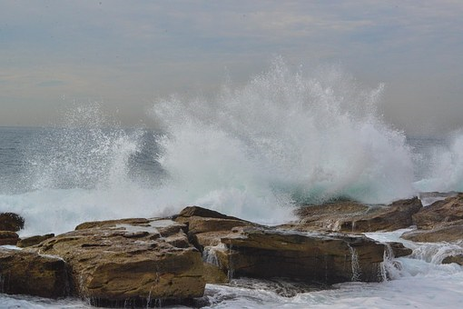
What about Sea Water?
Did you know that about 15% of Sydney’s
water is supplied by a Desalination plant!
Image source: http://pixabay.com
Notes:
How do we supply water to places where there isn’t enough rainfall, surface water, or underground water supply?
‘Desalination’ is one method, which has been adopted in Sydney.
Desalination is the process of taking salt out of sea water, to provide us with water we can drink. We can’t drink sea-water!
If we filled a bucket with 1 litre of fresh water, and a second bucket with 1 litre of salty sea-water, there would be actually more water in the first bucket, as the second bucket contains water AND salt.
Event though we can’t usually see the salt, we know it is present (taste, smell, chemical properties of sea-water).
…………………………………………..
Extensions:
Desalination uses a process called “reverse osmosis” to separate the salt from sea water. This process uses a lot of energy.
For a virtual tour of Sydney’s desalination plant visit: http://www.sydneywater.com.au/Education/Tours/DesalVirtualTour/tour.html

Slide 9

Salt-water is called a “Solution”
Water
Salt Water
Image source: http://pixabay.com and SMART
Notes:
We’ve looked at particles in muddy water.
Clear water can also contain particles – but so small we can’t see them.
Salt-water is an example of a clear solution.
Salt water is a mixture of water and salt.
The particles in a solution are so small, they can’t be separated out by filtering, and they can’t be seen by the naked eye. You cannot see the salt, and the salt and water will stay mixed as solution if left alone.
A solution is a specific type of mixture where one substance is completely dissolved into another. Dissolving means to completely mix into a solution.
Some substances can dissolve easily into others, while others cannot. There is a limit to how much of one substance can dissolve in another.
………………………………
Extension:
A solution is the same, or uniform, throughout. We call it “homogeneous”.
The liquid in a solution is called a “solvent”.
The particles dissolved in a solvent are called a “solute”.
Solubility is the measure of how much solute can be dissolved into a litre of solvent.
When a solution reaches the point where it cannot dissolve any more solute, it is considered “saturated”.

Slide 10
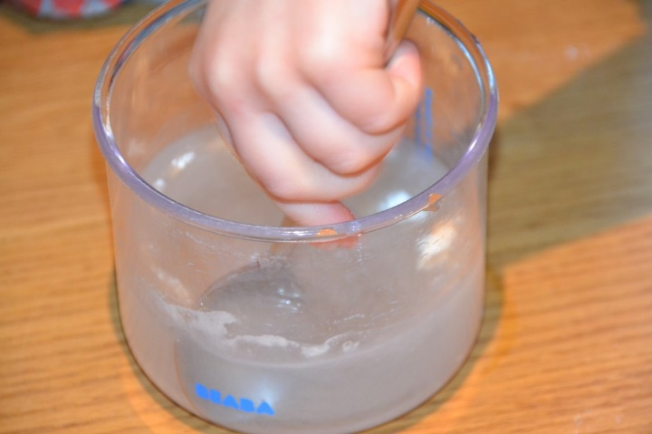
Salty Water
Aim: To observe how substances dissolve in water
Materials (per group):
2 clear cups or jars
1/2 cup of salt
1 tablespoon of pepper (or sand)
2 spoons
500ml water
Marker
Procedure:
Form into groups of 2 to 3.
Pour an equal amount of water into each cup.
Use the marker to label one cup ‘salt’. Add a spoonful of salt to this cup.
Use the marker to label the second cup ‘pepper’. Add a spoonful of pepper
to this cup.
Stir both cups and observe. What do you see? Record your results.
Now, continue to add more spoonful's of salt to the ‘salt’ cup, stir each time.
Observe and record your results.
Image source: http://www.science-sparks.com/
Notes:
Now we’re going to observe the processes called dissolving, and see if we can form a clear solution.
Before performing the experiment, reinforce the Scientific Method by discussing with the students a hypothesis about what might happen. Then assist students to perform the experiment to confirm or disprove the hypothesis. Discuss what was observed (the results), and explore student ideas on why this may have happened.
This experiment explores dissolving. Dissolving means to completely mix into a “solution”. Some substances can dissolve easily into others, while others cannot. There is a limit to how much of one substance can dissolve in another.
Refer to RISK ASSESSMENT for Module 2 before conducting experiment.
Refer to Experiment notes (E2.2.2 in Coordinator Notes for Module 2.2)
……………………………….
Extensions:
Is there a difference between warm and cold water? Can you dissolve more or less salt in warm water?
What else does / does not dissolve in water?

Slide 11
What is Osmosis?
Salt Water
Water
Fresh water molecules move into the salty water,
through the membrane (special fabric). Salt stays put.
Image source: SMART
Notes:
Imagine we placed an empty container on a table.
Imagine we then stretch a special type a fabric, a “semi-permeable membrane” down the middle.
This membrane can let water through, but not salt. The salt-particles won’t fit through the gaps in the fabric.
On one side of the membrane, we place a salt-water solution.
On the other side, we place fresh water.
The water molecules want to be spread out evenly, within the entire container. They want to reach what we call equilibrium, where there is equal amounts (of salt and water) on both sides. The fresh water will travel through the membrane, and mix into the salt-water solution. This will “dilute” the salt water over time, making it less salty. This process is called OSMOSIS. Osmosis is a passive process. This means that it doesn’t require an input of energy, it happens naturally.
………………………..
A semi-permeable membrane is a membrane that will allow some atoms or molecules to pass but not others. A simple example is a screen door. It allows air molecules to pass through but not pests or anything larger than the holes in the screen door. Another example is Gore-Tex clothing fabric that contains an extremely thin plastic film into which billions of small pores have been cut. The pores are big enough to let water vapour through, but small enough to prevent liquid water from passing.
Reference: http://puretecwater.com/reverse-osmosis/what-is-reverse-osmosis

Slide 12
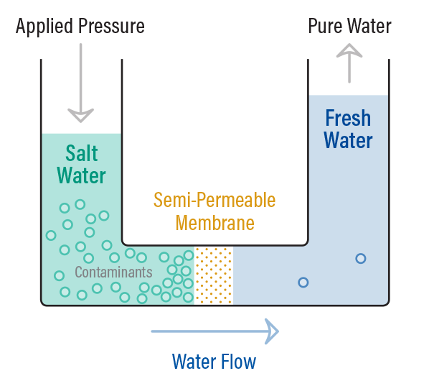
Reverse Osmosis
Image source: http://puretecwater.com/reverse-osmosis/what-is-reverse-osmosis
Notes:
Osmosis is a passive process. This means that it doesn’t require an input of energy, it happens naturally.
The process of REVERSE OSMOSIS on the other hand, requires a lot of energy input. Reverse osmosis is the process used in desalination plants, to separate salt and water out of sea-water. Salt-water is pushed under pressure through a semi-permeable membrane, that the salt can’t fit through. Fresh water is separated out, and the salt is left behind.

Slide 13
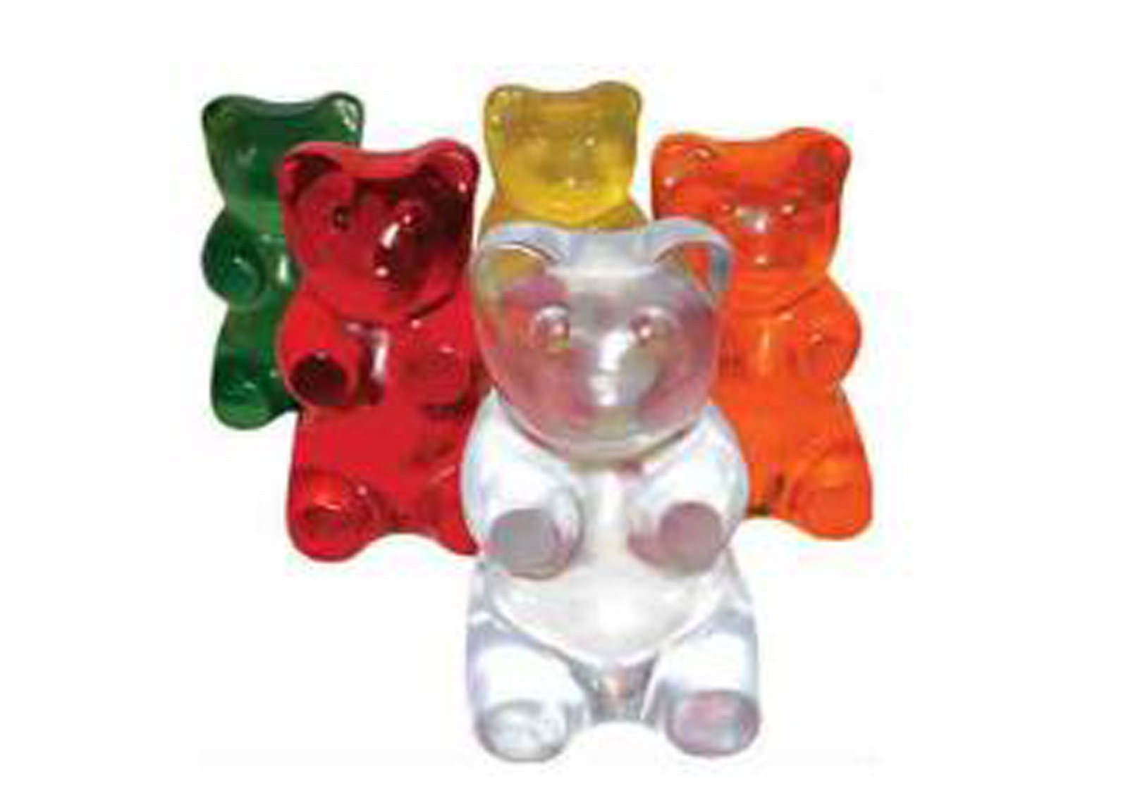
Osmosis
Aim: to observe the effect of osmosis
Materials (per person):
gummy bears (or raw potato pieces)
3 clear cups or jars
3 tablespoons of salt
300ml water
Marker
Spoon
Ruler
Procedure:
Label the three cups “salt water”, “fresh water” and control.
Fill the fresh water and salt water cups half full with water. The control cup remains empty.
Add 3 tablespoons salt to the salt water cup and stir for a minute.
Add a gummy bear to each cup and leave them overnight (at least 4 hours).
Observe the record the difference in the 3 gummy bears the next day.
Alternately, cut a raw potato into evenly sized sticks, approx. 1cm wide x 1 cm x 4cm long. Measure the pieces and record the sizes. Place a piece of potato into each cup. Set aside and observe after 20 minutes. Measure the pieces. Have they changed size?
Notes:
Now we’re going to observe the process of osmosis.
The gummy bears (and the potato) contain small amounts of water.
Lets see what happens if we soak them in fresh water compared to salt water.
Before performing the experiment, reinforce the Scientific Method by discussing with the students a hypothesis about what might happen. Then assist students to perform the experiment to confirm or disprove the hypothesis. Discuss what was observed (the results), and explore student ideas on why this may have happened.
Optionally, the facilitator may choose to conduct the experiment the night before, to show students the results they can expect – particularly recommended if students take the experiment home.
Refer to RISK ASSESSMENT for Module 2 before conducting experiment.
Refer to Experiment notes (E2.2.3 in Coordinator Notes for Module 2.2)

Slide 14
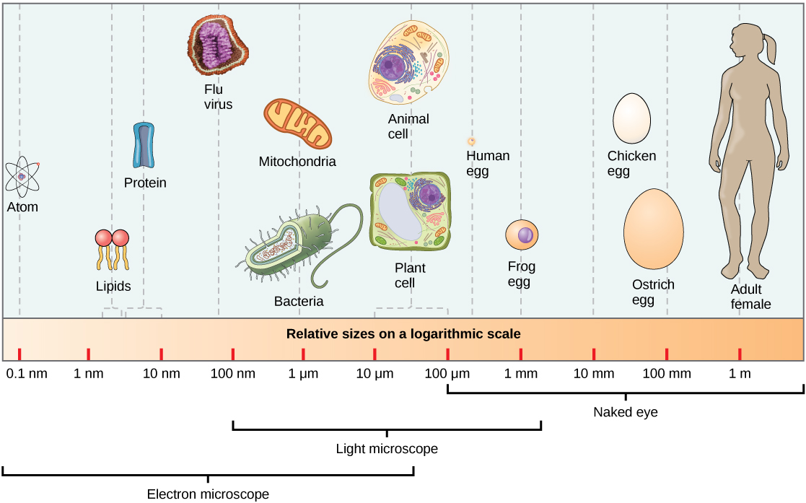


Pathogens are micro!
Image source: http://cnx.org/resources
Notes:
We call the bugs that make us sick pathogens. Sometimes dirty water can contain pathogens, but we can’t see them because they are extremely small.
They can be present in both muddy and clear water.
The main pathogens in dirty water are called bacteria, viruses and protozoa.
Viruses and bacteria are so tiny, they can only be seen with a microscope.
They are more than 1 million times smaller than we can see with our naked eyes.
They are what we call microorganisms.
Water needs to be free from pathogens to be safe to drink. Because pathogens are so tiny, they are very difficult to filter out. Instead, water treatment plants use a chemical process called ‘disinfection’ to treat and destroy pathogens in water, to ensure our water is safe to drink.
…………………………………………………………………………..
Pathogen Sizes:
Viruses: 20 – 400 nm (nanometres)
Bacteria: most are about 2 – 8 µm but some can be as long as 600 µm and some as short as 0.5 µm
Protozoa: 5-500 µm
Note:
µ stands for ‘micro’ and 1 µm is 0.000001 m (1 x 10⁻⁶ m)
n stands for ‘nano’ and 1 nm is 0.000000001 m (1 x 10⁻⁹ m)
m stands for ‘metres’
……………………………….
Extension:
These sicknesses are caused by pathogens:
Cholera – caused by the bacterium V. cholerae
Malaria – caused by plasmodium parasite
Severe Diarrhoea – caused by the bacterium E. coli
There are a few ways commonly used to disinfect water, these include:
Adding chlorine to the water (for short storage times, 1 to 2 days)
Adding chloramine (produced by reacting chlorine and ammonia) for systems with long pipelines
Disinfection sometimes requires the pH of the water to be adjusted to be more effective (a change to more acidic or more basic). Ultraviolet (UV) light is sometimes used to complement chemical disinfection.

Slide 15
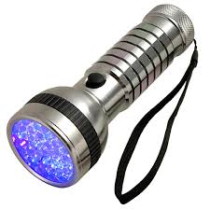
Micro-
organisms
Aim: To simulate and observe microorganisms in water
Materials (per group):
1/8 teaspoon ‘GlitterBug’ powder (a small pinch)
2 clear cups or jars
150ml water
Spoon or stirring stick
3 sheets paper towel
UV light / torch (shared between groups)
Procedure:
Form into groups of 2 – 3 students.
Half-fill 1 cup / jar with water.
Observe the water with the UV torch / light. What do you see?
Add a pinch of GlitterBug to the water in the cup, stir for 1 minute.
Observe the mixture of GlitterBug & water with the UV torch / light.
Place 1 piece of the paper towel over the empty cup / jar, and push down gently so the paper towel forms a shallow bowl inside the cup.
Slowly pour the water and GlitterBug mixture into the empty cup, using the paper towel as a filter.
Remove the paper towel and observe it with the UV light.
Observe the filtered water with the UV light.
Image source: https://glitterbug.net.au
Notes:
Now we’re going to simulate microorganisms dissolving in water, and experiment to see if we can filter them out.
Before performing the experiment, reinforce the Scientific Method by discussing with the students a hypothesis about what might happen. Then assist students to perform the experiment to confirm or disprove the hypothesis. Discuss what was observed (the results), and explore student ideas on why this may have happened.
Refer to RISK ASSESSMENT for Module 2 before conducting experiment.
Refer to Experiment notes (E2.2.4 in Coordinator Notes for Module 2.2)

Slide 16
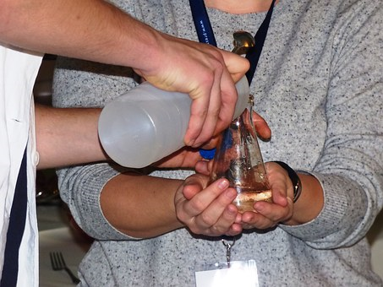
How else could we clean water?
Image source: http://www.pixabay.com/
Notes:
Water treatment plants are not possible in every community around the world. Engineers and scientists have worked hard to find creative, safe and cost effective ways to clean water and make it safe for drinking.
Between 1990 and 2015, 2.6 billion people gained access to improved drinking water sources.
(United Nations, Millennium Goals, Report 2015 http://www.un.org/millenniumgoals/news.shtml).
However, there are still lots of places in the world where people don’t have access to clean water.
Has anyone heard of any other ways to clean (or “purify”) water to make it safe for drinking?

Slide 17
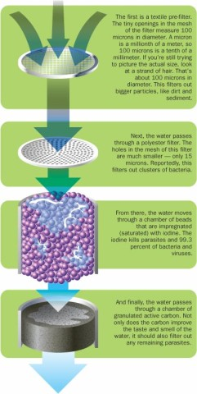
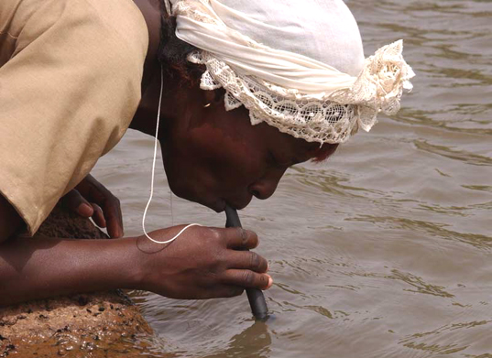
LifeStraw: Portable, cylinder shaped tube with a very fine water filter inside
Textile filter
Polyester filter
Iodine beads
Activated carbon
Image source: http://inhabitat.com/6-water-purifying-devices-for-clean-drinking-water-in-the-developing-world/
Notes:
http://lifestraw.com/products/lifestraw/
LifeStraw is an example of a portable, personal water treatment device.
The straw-style filter design lets you turn up to 1,000 litres of contaminated water into safe drinking water. It removes 99.9999% of waterborne bacteria. However, it doesn’t remove chemicals, salt water, heavy metals and viruses.

Slide 18
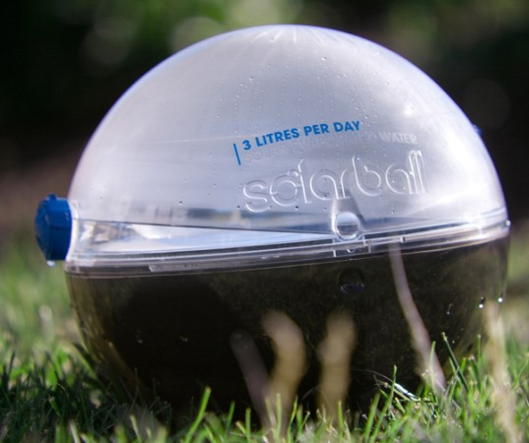
Solar Ball: Portable sphere, uses the suns energy to evaporate water to separate it from dirt / waste.
Image source: http://inhabitat.com/6-water-purifying-devices-for-clean-drinking-water-in-the-developing-world/
Notes:
Dirty water is poured inside, and the unit is shut; the ball then absorbs sunlight, which causes the dirty water inside to evaporate. Evaporation causes contaminants to separate from the water, generating potable water in the form of condensation, which can be collected and stored, ready for drinking. The Solarball can produce up to 3 litres of clean water per day. However, it doesn’t remove bacteria, chemicals, heavy metals and viruses.
http://inhabitat.com/6-water-purifying-devices-for-clean-drinking-water-in-the-developing-world/

Slide 19
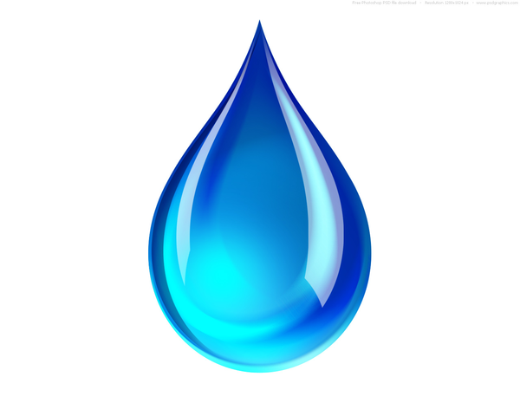
Water Filtration
Challenge!

Slide 20
Water Filtration Challenge!
Construct a water treatment system using flocculation and filtration methods to clean dirty water!
Water treatment teams will be scored on:
How much clean water makes it to the town
How clean the water appears!
Notes:
Optional Storyline:
A community has called for help! Their water treatment plant has broken down, and they need help to provide clean water to the town taps while the plant is being repaired.
Your task is to come up with a filtration system to filter out all the leaves, dirt and rubbish caught in the water upstream of the treatment plant.

Slide 21
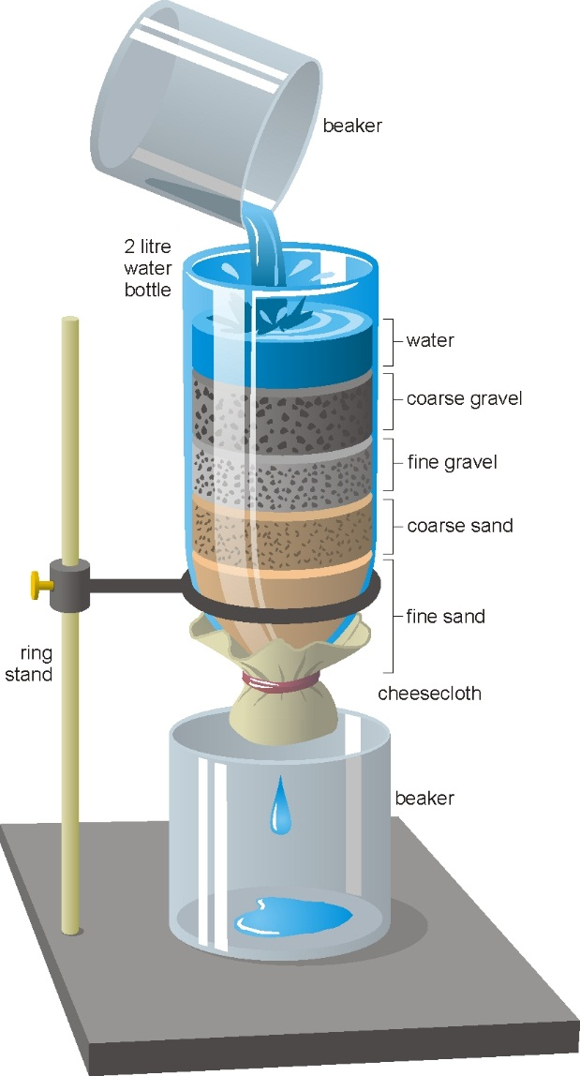
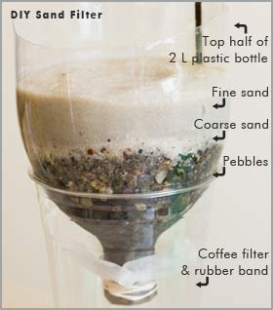
Design your Filtration System
Images: http://www.hometrainingtools.com/a/water-filtration-science-project
https://www.crd.bc.ca/education/school-programs/for-k12-teachers/educator-guides-resources/drinking-water/water-in-our-community
Notes:
https://www.crd.bc.ca/education/school-programs/for-k12-teachers/educator-guides-resources/drinking-water/water-in-our-community
http://www.hometrainingtools.com/a/water-filtration-science-project

Slide 22
Filtration Challenge Rules
Your final filtration system is limited to three of the filtering / flocculation materials. Choose up to three materials you think will clean water the best when combined.
Crushed and uncrushed materials of the same substance can both be used, and will be counted as one material.
You decide how much of any one material is used for your system.
Aim for at least 50 mL of water to make it through the system into the “drinking” cup.
Do not drink the water (dirty or filtered)!
You will be scored based on: visible contaminants (floating chunks), turbidity (cloudiness/colour) and whether you managed to any water!

Slide 23
References
Drinking Water Treatment Processes, Water Supply, Pathogens
https://www.hunterwater.com.au/Water-and-Sewer/Water-Supply/Water-Treatment-Processes.aspx
https://www.sawater.com.au/community-and-environment/our-water-and-sewerage-systems/water-treatment/conventional-water-treatment-plants
https://www.watercorporation.com.au/home/education/teaching-resources/elearning
http://hsc.sca.nsw.gov.au/biology/water-pathogens
Desalination Facts
http://www.ffc.org.au/FFC_files/desal/Whatisdesalination-factsheet-1.pdf
Solutions and Dissolving
http://www.ducksters.com/science/chemistry/solutions_and_dissolving.php
Osmosis & Reverse Osmosis
http://puretecwater.com/reverse-osmosis/what-is-reverse-osmosis
http://www.science-sparks.com/2015/04/18/osmosis-made-easy/
https://sciencing.com/osmosis-kids-8650496.html

