Slide 1
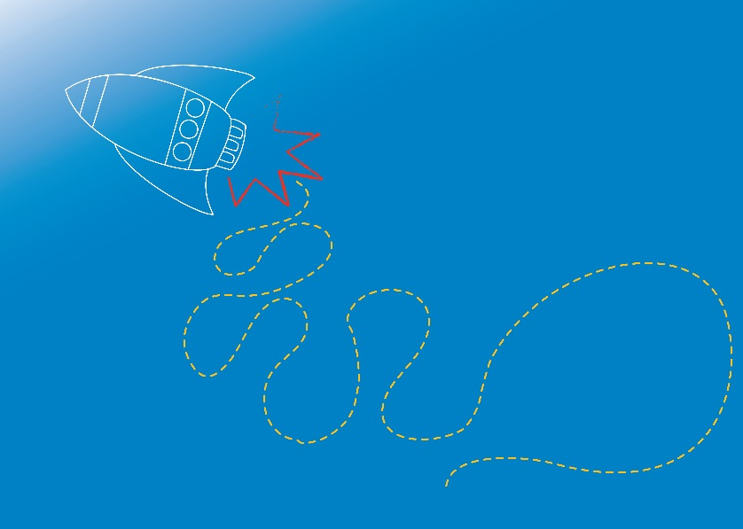
WATER
Wonderful Water
Module 2.1
Notes:
Welcome back, and welcome to new participants!
In Module 1, we explored the science around AIR.
In this Module, Module 2, we will explore the science around WATER!

Slide 2
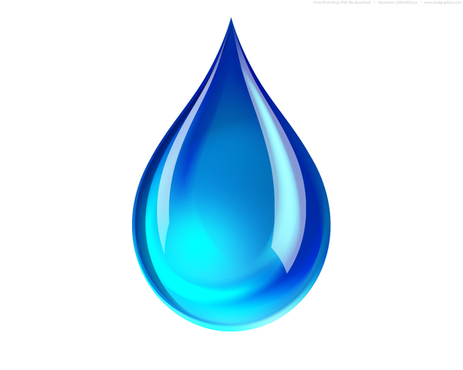
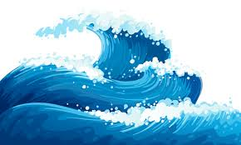
What do we already know about WATER?
Image source: https://pixabay.com/
Notes:
What do we know about water?
Encourage students to share what they already know!
Ask students what words they think of when they think about water?
Perhaps: wet, drink, swim, droplet, ocean?
Maybe fluid, flow, liquid?
Ask students when they have noticed water in the world around them?
Perhaps on rainy days, swimming, washing dishes, filling up drink bottles?
In this module, we will explore what water is made of, learn some cool scientific words to describe waters properties, and perform some fun experiments!

Slide 3
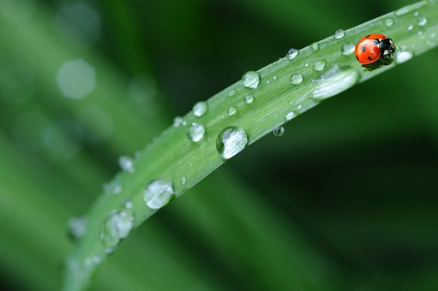
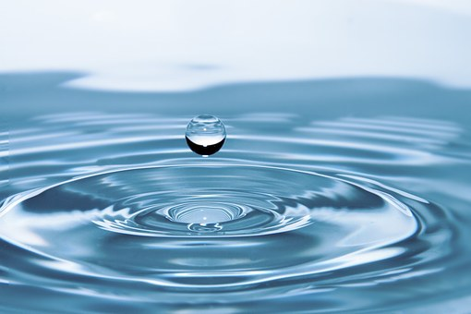
Watery fact …or fiction?
A tomato is 95% water
Human brains are 60% water
A chicken is 75% water
Image source: https://pixabay.com/
Notes:
Intro Game: Fact or Fiction
Invite students to guess which of the three “facts” about water has been made up!
‘Facts’…. 1. A tomato is 95% water
2. Human brains are 60% water
3. 75% of a chicken is water.
Answer: Number 2 is false – human brains are 75% water
Fact source: http://blueplanet.nsw.edu.au/water-facts/.aspx

Slide 4
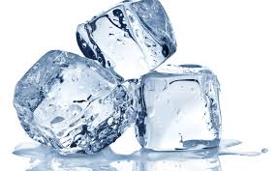
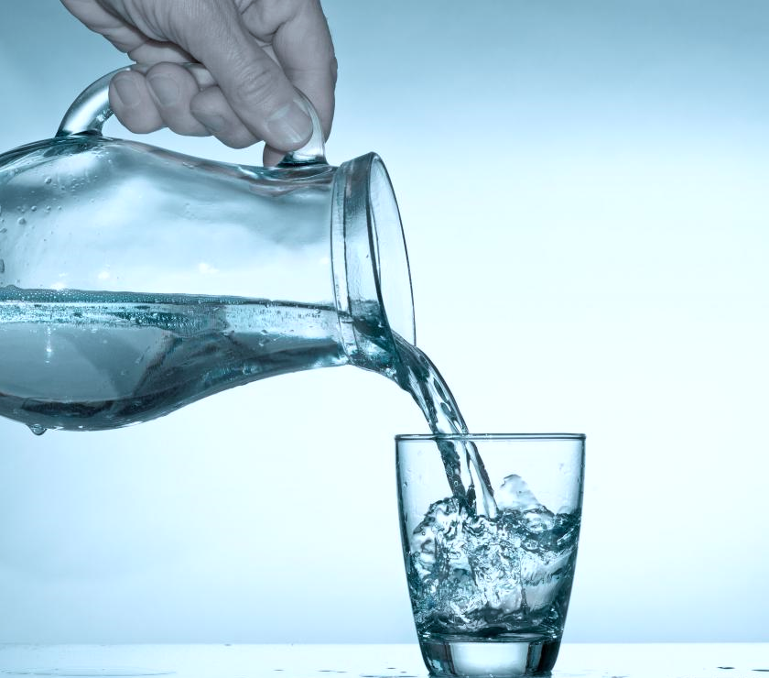
Three States of Matter: Solid, Liquid, Gas
Image source: https://pixabay.com/
Notes:
Scientists have a name for what things are made of: they call it “matter”.
Everything around us is made of matter – this room, your clothes – and you!
Some matter is so tiny, we need special equipment, like magnifying glasses and microscopes, to see it.
Some matter is invisible (like the air around us).
There are three main states of matter, and we call these: solid, liquid and gas.
Most substances can exist in all three states. They changes from one state to another depending on how hot they are. Water is the only matter that occurs naturally on earth in all three states: as liquid water, solid ice, and vaporous steam (gas).
Ask students when they might see water in it’s different states?
Examples:
Frozen (solid) water: ice cubes, ice blocks, snow, snow flakes
Liquid water: rain, running from taps, puddles, lakes, oceans
Gaseous water: steam from kettles, steam from boiling pots.
Ask students what might cause water to change states?
Answer: heating, cooling.

Slide 5
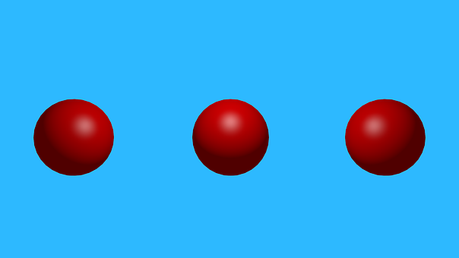
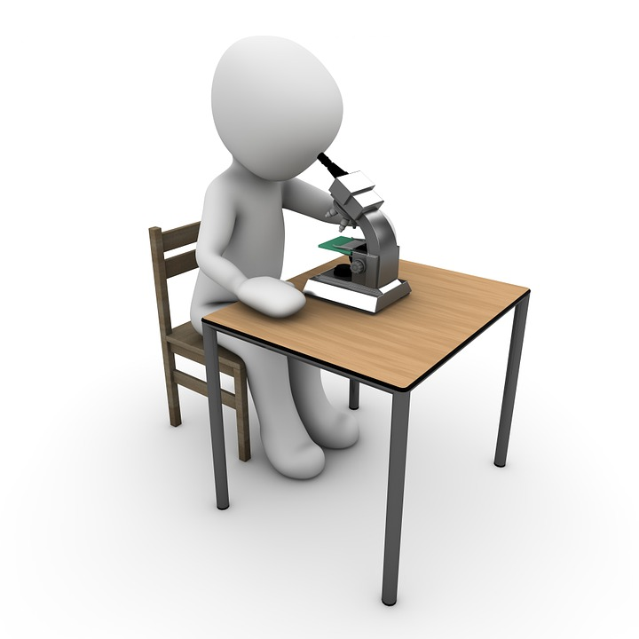
All matter is made of…
Atoms!
Image source: https://pixabay.com/
Notes:
All matter, or stuff, is made up of tiny building blocks called atoms.
An atom is very small, a bit like a tiny ball.
There are about 100 different types of atom, and these are all different sizes (though all very tiny).
Each type of atom makes one type of matter, called an element.
Some common elements are: iron, calcium, and gold.
Iron is used to make pans, cars, bridges.
Calcium is an element found in our teeth and bones.
We make jewellery from gold atoms.
A piece of paper, or a page in a book, can be more than 1 million atoms thick.
If you cup your hands together with some air inside, you’ll be holding more than a thousand-million-million (1,000,000,000,000,000) atoms of air!

Slide 6
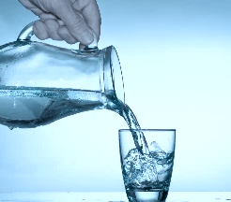
Atoms are tiny!
Solid Liquid Gas
Image source: SMART and https://pixabay.com/
Notes:
In each state of matter (solid, liquid and gas) atoms and behave differently.
Substances change from one state to another depending on how hot, or how excited, their atoms are.
Solids: In solids, atoms are very close together. Atoms are fixed together firmly in a set pattern, in a fixed shape. The atoms in solids don’t move far away from each other. When a solid is heated up enough, it melts and changes into a liquid.
Liquids: In liquids, atoms are less tightly packed together than in solids. The atoms in liquids can move around, and swap places. The means a liquid can flow and be poured into a container, or be separated into droplets. When a liquid is heated up enough, it turns into a gas.
Gases: In a gas, atoms are separate from each other, and can zoom around at high speeds. A gas spreads out and fills the area it is in. Gases have no shape and are often invisible.

Slide 7
H₂O Water Molecules!
H
H
O
O
O
1 Oxygen molecule (2 oxygen atoms)
+
H
H
δ -
2 Hydrogen molecules (4 hydrogen atoms)
O
H
H
Can combine to create 2 water molecules!
H
H
Image source: SMART
H₂O
Notes:
When atoms group together, we call them molecules. Some molecules are made up of just one type of atom. Others are made up of different types of atoms joined together.
Oxygen is an element. It contains one type of atom – oxygen. An oxygen molecule is made up of two oxygen atoms.
Hydrogen is another element. A hydrogen molecule is made up of two hydrogen atoms.
Hydrogen atoms are smaller than Oxygen atoms.
When one oxygen molecule and two hydrogen molecules meet, there is a chemical reaction. The atoms separate, and form two new molecules. Each new molecule has one oxygen atom and two hydrogen atoms.
These molecules make a new substance. It is unlike hydrogen or oxygen, and it is called WATER!
Because a water molecule is very tiny (microscopic) in size, it takes billions of water molecules to make even the smallest droplet of water.
*If you have access to a molecular modelling kit, it would be fantastic to use here to make a water molecule with participants (local schools and universities may loan out a molecular modelling kit).
Let’s do an experiment to observe some cool properties of liquid water molecules!

Slide 8
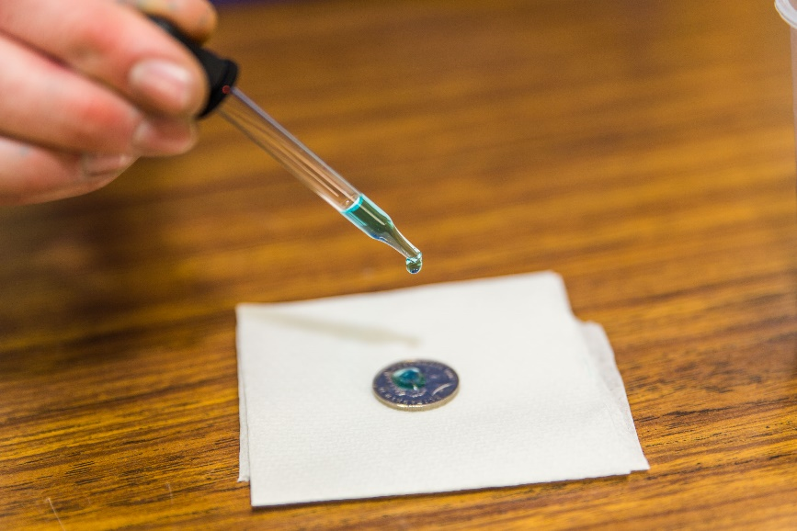
Wobbly Water
Aim: To observe the properties of liquid water
Equipment (per group):
1-2 cups of water
1 small shallow bowl / jar
2 pipettes / straws
2 or more coins
Paper towel
Procedure:
Form a group of 2 to 3 students.
Slowly fill the shallow bowl / jar right to the top with water.
Take turns to add additional drops of water to the ‘full’ bowl / jar using a pipette or straw.
Observe how many drops will fit in. Look closely at the edge of the bowl / jar at eye level. What can you see as more drops are added?
Now take turns to add drops of water onto a coin, using the pipette / straw. How many drops can fit on a coin?
What do you see?
Image source: SMART
Notes:
Now we’re going to observe some of the cool qualities of wonderful water!
Before performing the experiment, reinforce the Scientific Method by discussing with the students a hypothesis about what might happen. Then assist students to perform the experiment to confirm or disprove the hypothesis. Discuss what was observed (the results), and explore student ideas on why this may have happened.
This experiment explores surface tension.
Refer to RISK ASSESSMENT for Module 2 before conducting experiment.
Refer to Experiment notes (E2.1.1 in Coordinator Notes for Module 2.1)

Slide 9
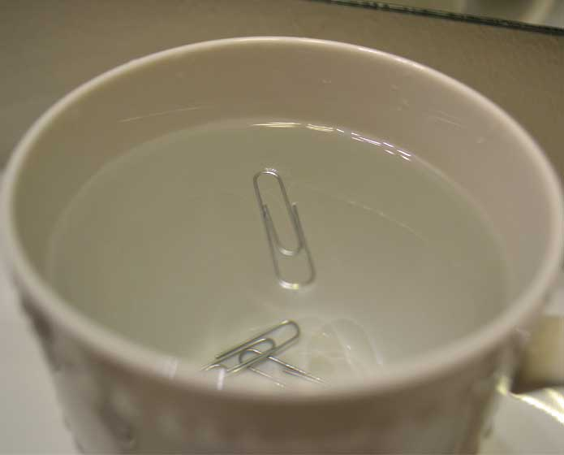
Sink or Float
Aim: To observe surface tension in a cup of water
Equipment (per group):
1 cup of water
1 Paperclip
2cm x 2cm piece aluminium foil
Procedure:
Form a group of 2 to 3 students.
Fill a cup with water.
Place a paperclip flat and gently on the surface of the water.
Observe. What do you see?
Place the paperclip gently on the water surface in a different way. What do you see?
Tear off a piece of aluminium foil (up to 2cm in width / length). Place it gently on the surface of the water.
Observe. What do you see?
Place the foil gently on the water surface in a different way. What do you see?
Image source: http://sciencewithkids.com/
Notes:
This experiment demonstrates surface tension. Before performing the experiment, reinforce the Scientific Method by discussing with the students a hypothesis about what might happen. Then assist students to perform the experiment to confirm or disprove the hypothesis. Discuss what was observed (the results), and explore student ideas on why this may have happened.
Refer to RISK ASSESSMENT for Module 2 before conducting experiment.
Refer to Experiment notes (E2.1.4 in Coordinator Notes for Module 2.1)

Slide 10
What’s happening?
There are forces in water!
Surface Tension…
…Cohesion
Image source: SMART
Notes:
Explanation: Water molecules want to stick to other water molecules, and they hold on tightly to their neighbours below and next to them. When molecules ‘stick’ or “bond” together, we call this COHESION.
The water molecules on the surface of the water have water molecules below them, and next to them as neighbours. Because there are no water molecules above them, only air, the water surface acts like it has a thin ‘skin’. We call this Surface Tension.
Wobbly Water:
As you add more drops onto the coin (or into the jar/bowl), the force of gravity (pulling downwards) becomes stronger than the force of attraction among the water molecules at the surface. This causes the water to spill over the edge of the coin/jar.
Sink and Float:
You can think of surface tension a bit like a thin film on top of the water (like a spider web, or thin trampoline mat). When a weight/object lands on the water surface, it bends down. If the force (pressure) from the weight is more than the strength of the surface tension of the water molecules, the object will break through the surface and sink.

Slide 11
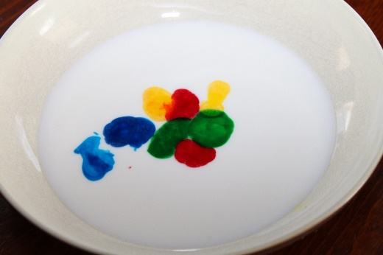
Can we observe surface tension in milk?
Image sources: http://busybugs.co/wp-content/uploads/2013/03/IMG_6164.jpg
Notes:
Cohesion and surface tension forces are present in other liquids too.
We can observed surface tension when we added drops of water to the bowl/jar and onto the coin. When the surface tension was weakened, the water molecules were held less tightly together, and the liquid flowed out of the jar and off the surface of the coin.
Let’s do a fun experiment with milk, soap and food colouring to see if we can see surface tension in action in a different way.

Slide 12
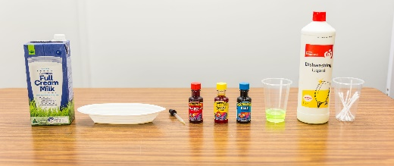
Rainbow Milk
Aim: To observe the effect of soap on the surface tension of milk.
Equipment (per group):
1 shallow bowl or plate
1/2 cup of full cream milk
Drops of food colouring
1 small cup / bowl
1 blob of dishwashing liquid/soap (1 Tbsp.)
1 cotton tip
Procedure:
Form into groups of 2 to 3 students.
Fill a shallow bowl/plate with enough milk to cover the bottom.
Scatter a few drops of different coloured food colouring across the surface of the milk.
Place a blob of dishwashing liquid/soap in a small cup / bowl.
Dip a cotton tip in dishwashing liquid/soap. Then, place the dipped cotton tip into the milk and observe what happens.
Repeat step 5 to view the effect again.
Image sources: http://busybugs.co/wp-content/uploads/2013/03/IMG_6164.jpg and SMART
Notes:
Cohesion and surface tension forces are present in other liquids too. Milk is made mostly of water, but it also contains vitamins, proteins and suspended fat droplets.
Before performing the experiment, reinforce the Scientific Method by discussing with the students a hypothesis about what might happen. Then assist students to perform the experiment to confirm or disprove the hypothesis. Discuss what was observed (the results), and explore student ideas on why this may have happened.
So what is happening? The colours swirl and zoom around when the soap is added.
Milk stays together as one liquid, because of cohesion and surface tension between the milk molecules. The surface tension acts like a thin skin.
When you add the soap, it breaks the surface tension (skin) of the milk in one spot. The pull of the surface tension from the milk at the edge of the bowl/plate then causes the milk in the centre to move toward the edge, taking the colours along with it.
The colours will keep moving until the soap stops affecting the surface tension of the milk.
(Explanation adapted from: http://www.csiro.au/en/Education/DIY-science/Chemistry/Amazing-detergent)
Refer to RISK ASSESSMENT for Module 2 before conducting experiment.
Refer to Experiment notes (E2.1.2 in Coordinator Notes for Module 2.1)
……………………………………………………..
EXTENSION: Molecules that reduce the surface tension of other liquids are called surfactants. Dishwashing liquid is a common surfactant.

Slide 13
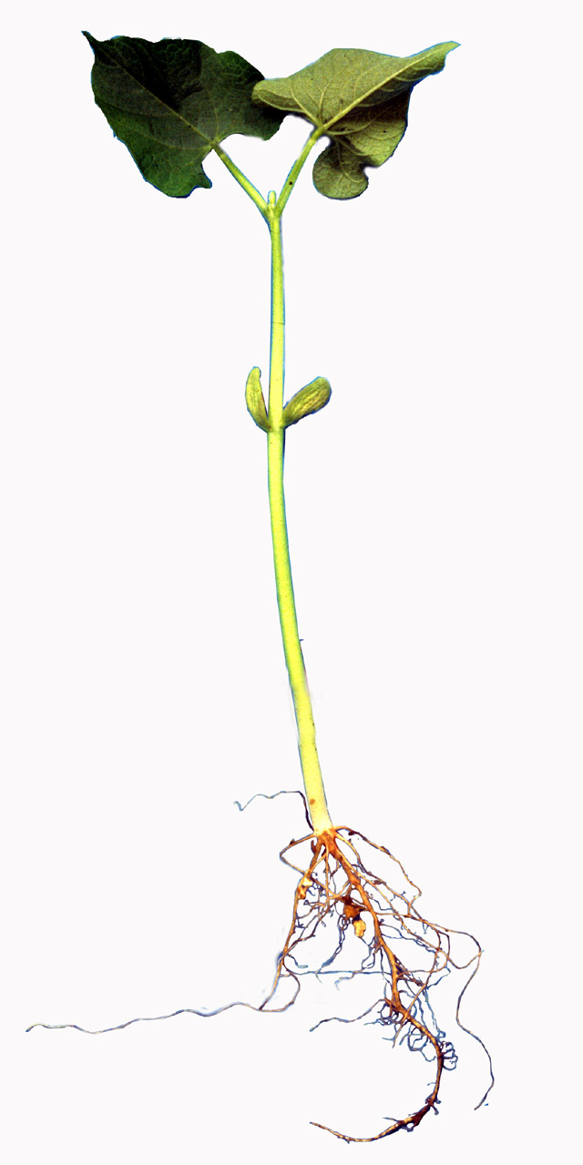
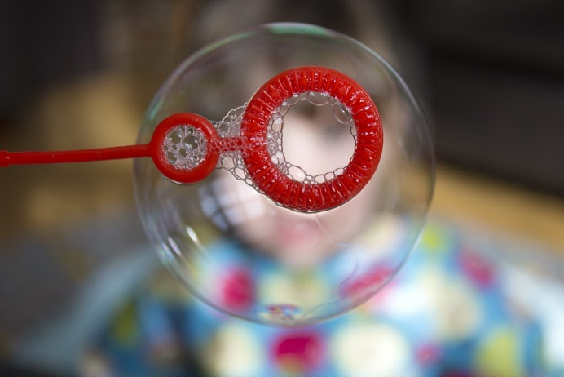
Cohesion is cool!
Water is pulled into plant roots by COHESION
Image sources: SMART and botit.botany.wisc.edu and pixabay.com and https://chem.libretexts.org/
Notes:
Remember COHESION is the name for when molecules of the same substance ‘stick’ or ‘bond’ together.
Ask students where we might see cohesion in nature, or in everyday life?
Blowing bubbles: Cohesion makes the surface of the bubble liquid behave like a stretchy, rubber sheet, and hold together around the air inside.
Water Bugs: The water strider, can run across the surface of water, due to the cohesion of the water molecules, and the force of the strider which is evenly distributed to its legs.
PLANTS: Cohesion actually allows plants to draw water (and nutrients) into their roots. Plants need water and nutrients to stay alive, so this is a vital process in plants. The force of cohesion allows this process to work without the plant having to use its own energy.
…………………………………………………
Extension: This entire process in plants is called TRANSPIRATION! Water evaporates out of plants into the atmosphere (through their leaves). This process creates a continuous pull of cohesion through the plant, from the leaves to the roots, drawing water (and dissolved nutrients) into the plant.

Slide 14
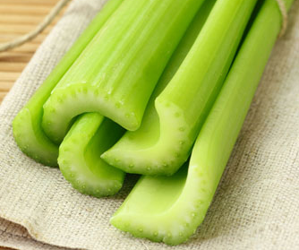
Can we observe cohesion?
Celery Stalk
Xylem
Image source: http://www.shutterstock.com/
Notes:
Water moves through plants from their roots to their leaves. The ‘pipes’ which transport the water are called XYLEM. In this next experiment, we are going to see how water is pulled through a plant’s XYLEM using water COHESION.

Slide 15
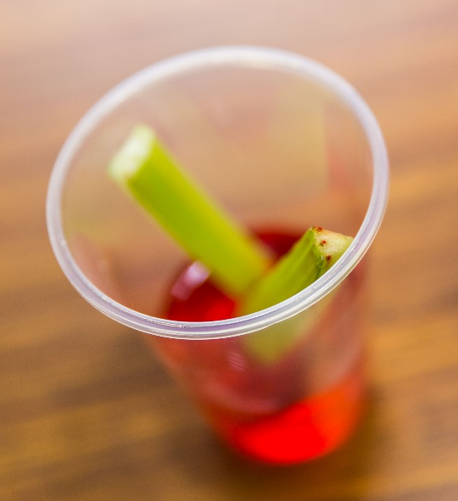
Celery Transport
Aim: To observe the movement of water through a plant.
Equipment (per group):
1 short celery stalk, with leaves attached
1/2 cup water
1 cup
Drops of food colouring
Scissors
Procedure:
Form into groups of 2 to 3 students.
Fill a cup with water and add a few drops of food colouring.
Observe the end of a piece of celery, can you see the xylem tubes?
Place the base of the celery into the coloured water
Leave near a window till the following session (max 1 week later).
Observe the results.
Cut the stem in half with scissors to observe the cross-section.
Image source: SMART
Notes:
Hand out the celery (cut the bottom of the stems so there is a clean cut to view the xylem) to the students and ensure that each student can see the xylem tubes. These are the ‘water pipes’ of plants.
Results take more than 2 hours to appear. Students will need to view the results at the beginning of their next science club session (max 1 week later) or you can allow students to take the experiment home.
Optionally, the facilitator may choose to conduct the experiment up to 1 week before / the night before, to show students the results they can expect – particularly recommended if students take the experiment home.
Before performing the experiment, reinforce the Scientific Method by discussing with the students a hypothesis about what might happen. Then assist students to perform the experiment to confirm or disprove the hypothesis. Discuss what was observed (the results), and explore student ideas on why this may have happened.
Refer to RISK ASSESSMENT for Module 2 before conducting experiment.
Refer to Experiment notes (E2.1.3 in Coordinator Notes for Module 2.1)

Slide 16
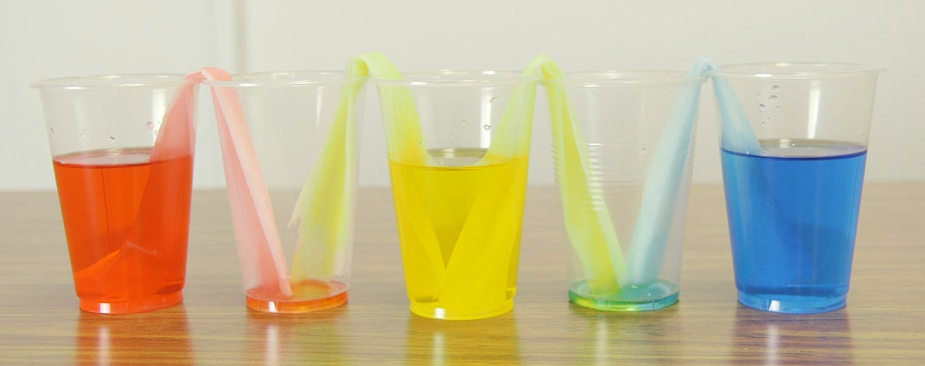
Wicking Water
Aim: To observe movement of water through paper.
Equipment (per student):
1 piece paper towel
1/2 cup water
2 cups
Drop of food colouring
Procedure:
Half fill one cup with water and add a few drops of food colouring.
Twist or fold a piece of paper towel into a tight roll.
Fold the roll in half.
Place one end of the twisted paper towel into the coloured water.
Place the other end into the second, empty cup.
Observe the results.
Image source: SMART
Notes:
This experiment can be conducted instead of, or in addition to, the Celery Transport experiment.
Before performing the experiment, reinforce the Scientific Method by discussing with the students a hypothesis about what might happen. Then assist students to perform the experiment to confirm or disprove the hypothesis. Discuss what was observed (the results), and explore student ideas on why this may have happened.
Refer to RISK ASSESSMENT for Module 2 before conducting experiment.
Refer to Experiment notes (E2.1.5 in Coordinator Notes for Module 2.1)

Slide 17
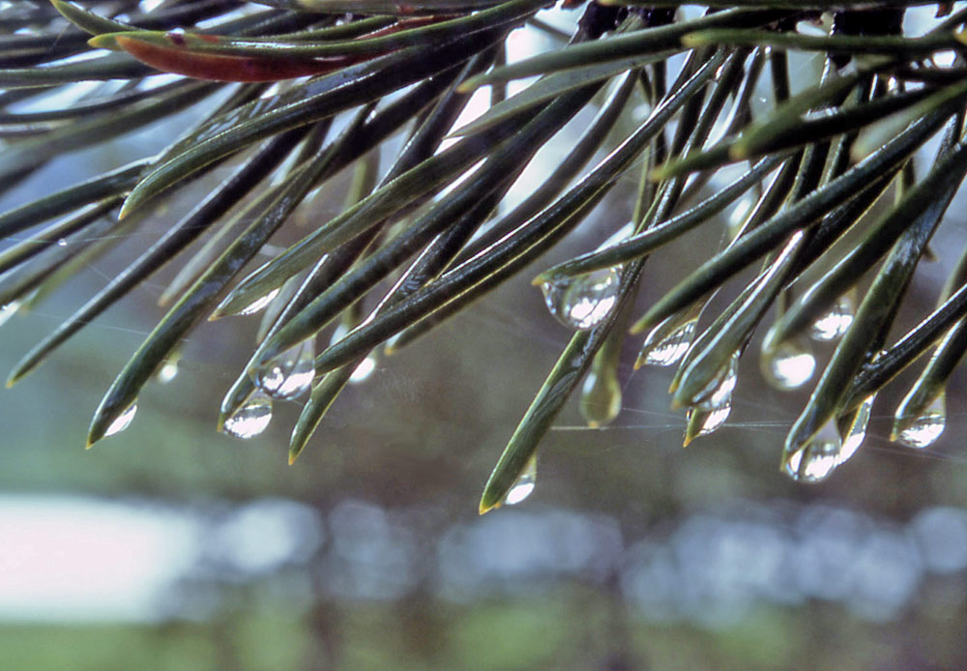
Cohesion, or, Adhesion?
Image source: http://www.nps.gov/features/yell/slidefile/plants/conifers/pine/Page.htm
Notes:
We have talked about how important (and cool!) cohesion is. Remember COHESION is the name for when molecules of the same substance ‘stick’ or ‘bond’ together.
ADHESION is a very similar concept. This is the word we use to describe the attraction between molecules of different substances!
For example, the water molecules in the picture are sticking to, or bonding to, the pine needles of this tree.

Slide 18
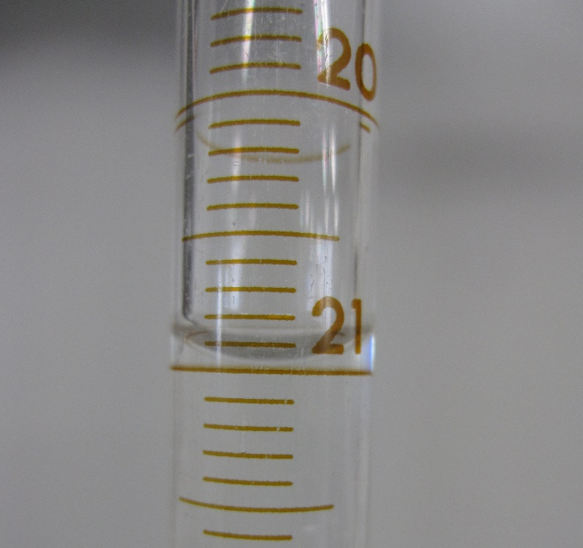
Can we observe adhesion?
H₂O = Water
Hg = Mercury
Meniscus
Image source: Wikimedia Commons and https://chem.libretexts.org
Notes:
When you fill a measuring cylinder or cup with water, you can see that the surface of the water is curved.
This is called the meniscus! The meniscus forms because of cohesion between the water molecules, and adhesion between the water molecules and the glass.
The adhesive attraction between the water and glass makes the water want to stick to the glass, and that’s why it curves up at the sides.
Ask students from which part of the meniscus they should measure to get the volume in a measuring cylinder…. (edge, centre, etc.)
Answer: When measuring liquid in a cylinder you should always measure from the centre of the meniscus. In the picture on the slide, the measuring cylinder is 21 millilitres full, not 21.2 millilitres.
Some liquids will have a ‘convex’ meniscus (curving at the top). Mercury has a convex meniscus in glass.
Water has a ‘concave’ meniscus (curving at the bottom) in glass. In some containers, for example a container made from Teflon, water will form a convex meniscus!

Slide 19
Water Transport
Challenge!

Slide 20
Water is needed!
The town of Waterloo is out of water!
The town’s taps have run dry.
During your investigation, you’ve discovered the water pipes from the town’s dam have broken.
How will you get water to the town,
while the engineers fix the broken pipes?

Slide 21
The Challenge:
Transfer water from the dam, to the town,
using only the powers of cohesion, adhesion
and surface tension!
Water transport teams will be scored on:
How much water makes it to the town
How many drops of water make it onto the storage stations (coins)!

Slide 22
Water Travelling on a String
https://www.youtube.com/watch?v=iJBHckmq_o0
Travelling Water Experiment, demonstrated by HooplaKidzLab
Notes:
This video demonstrates adhesion, water “sticking” to a string.
https://www.youtube.com/watch?v=iJBHckmq_o0

Slide 23
Anti-gravity Water
https://www.youtube.com/watch?v=94yRLJfqyv8
Anti-gravity water demonstration.
The Module 2 Video includes another demonstration.
Notes:
This video demonstrates surface tension, cohesion and adhesion. Water molecules ‘stick’ to the mesh. Cohesion between the water molecules themselves creates surface tension. The combined forces prevent the water from flowing out through the mesh.
https://www.youtube.com/watch?v=94yRLJfqyv8
The Module 2 Video includes a demonstration of this activity.

Slide 24
Water Transport Rules
Dam
The dam is high up in the mountains! You must first transport the water from the dam into your water vessel (cup) using only a piece of string and tape.
Road to Town
Travelling to the town is dangerous, so the water in the water vessel must be transferred into a special transport container (bottle) using only a straw.
With the water in the transport container, you can now start your journey to the town, however, the container has no lid… and must be transported to the town upside down! You have a rubber band, a plastic card and a piece of mesh to assist you. The plastic card must not leave the dam area.
If water is spilt and it does not land on a towel, it must be cleaned up immediately! The road to the town must remain dry!

Slide 25
Water Transport Rules
Town
You have made it back to town! Pour your water into a measuring cup (the holding tank!), and ask a supervisor to record the volume of water you were able to transport to town.
Now that you have recorded how much water you transported to town, the water must be stored!
The more water drops you can place onto the storage stations (20c coins) the further the water supply will reach across the town.
Transfer as many drops onto the three coins as you can, without the water overflowing. Transfer to one coin at a time. A supervisor or a student from another team will need to watch the storage process, to help count how many drops you store on each coin.

Slide 26
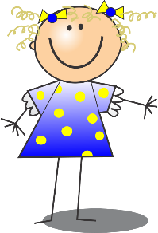
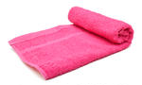
Challenge Set Up
String
Holding tank
Water vessel
Transport container
Storage stations
Dam
Towels or newspapers
1 metre to 2 metres

Slide 27
References
Anti-gravity water
https://www.stevespanglerscience.com/lab/experiments/water-screen/
Water travelling on a string
https://pbskids.org/zoom/printables/activities/pdfs/wateronastring.pdf
Water on a coin
https://www.questacon.edu.au/outreach/programs/science-circus/activities/count-the-drops
Wicking Water
http://www.sciencekids.co.nz/experiments/escapingwater.html
Rainbow Milk
http://splash.abc.net.au/home#!/media/2191105/rainbow-milk-experiment
Properties of Water & Water Facts
http://blueplanet.nsw.edu.au/water-facts/.aspx http://splash.abc.net.au/home#!/media/103352/the-surface-tension-of-water
https://water.usgs.gov/edu/waterproperties.html
https://www.kidsdiscover.com/teacherresources/water-buoyancy-cohesion-adhesion/

Slide 28
Water on a Coin
https://www.youtube.com/watch?v=8O8PuMkiimg
Water on a coin demonstration.
The Module 2 Video includes a demonstration of this activity.
Notes:
https://www.youtube.com/watch?v=8O8PuMkiimg
Water on a coin demonstration.
The Module 2 Video includes a demonstration of this activity.

