Slide 1
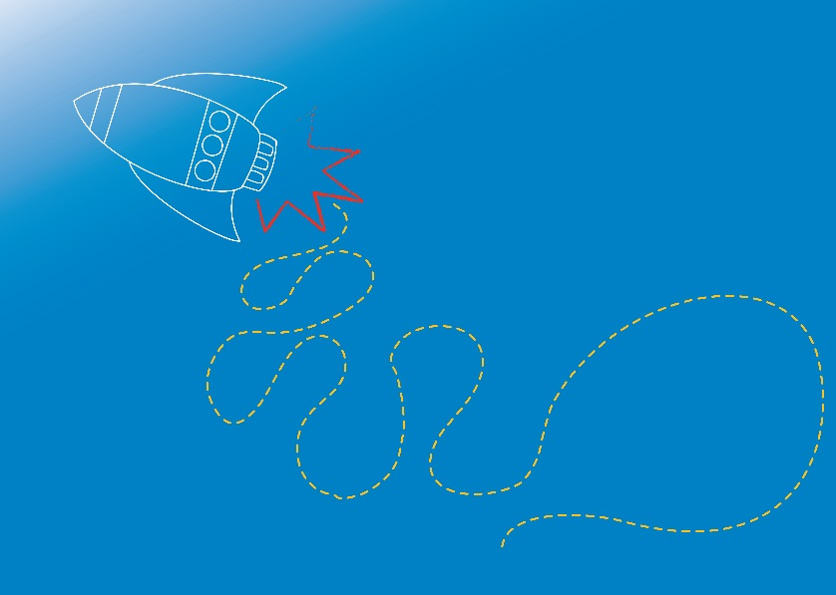
AIR & FLIGHT
Rockets and the Laws of Motion
Module 1.2
Notes:
Welcome back, and welcome to new participants!
In Module 1.1, we started to explore the science around air and flight. We looked at air, aerodynamics, and the forces of flight.
In this Module, we will continue to explore air and flight, and look at the science around rockets and the laws of motion. We’ll finish of by using what we discover to make our own rockets!
Let’s take a look at a short video of a rocket launching, to get us started.

Slide 2
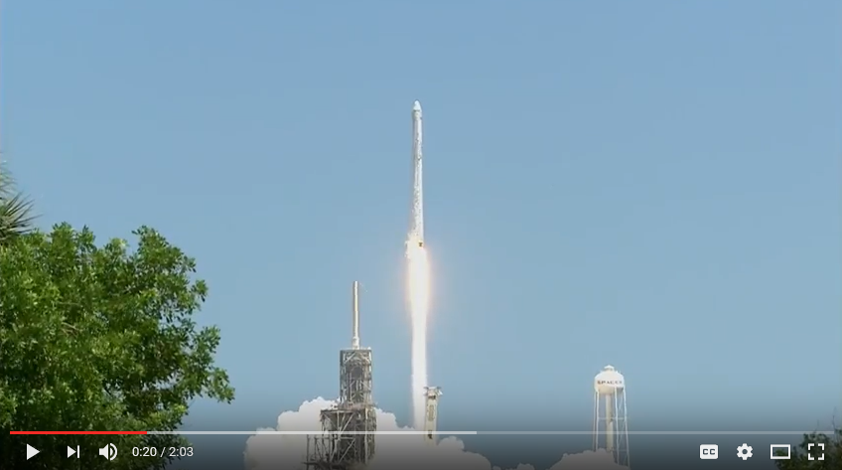
https://youtu.be/5e_TNLem-DU
NASA SpaceX Falcon 9 rocket launches to the International Space Station, August 2017
Video Source: https://www.nasa.gov/multimedia/videogallery/index.html
Notes:
Let’s watch a video clip of the American SpaceX CRS-12 Falcon 9 rocket, launching to the International Space Station, in mid-August 2017.
The SpaceX rocket lifts off with the Dragon cargo module, on its journey to the International Space Station.
Dragon delivered more than 3000 kilograms of research equipment, cargo and supplies to the space station for NASA.
Supplies included a sweet treat for the astronauts: ice cream. Small cups of chocolate, vanilla and birthday cake-flavoured ice cream arrived in freezers. Freezers were reloaded with research samples for return to Earth when the Dragon spacecraft departed the station mid-September 2017.
More information about the NASA and the SpaceX CRS-12 mission is available online www.nasa.gov/spacex.

Slide 3
Do you think aerodynamics is important for rockets too?
Pointed nose cone to push through air more easily, reducing drag
Fins and tail to help with stability
Notes:
Recap that Aerodynamics is the science of how air moves around things. It helps us to understand why different shapes move through the air differently.
Without an understanding of aerodynamics we wouldn’t have planes, space rockets, fast trains and many other useful inventions.
Ask students what they know or remember about aerodynamics and planes. Are the same things important for rockets?

Slide 4
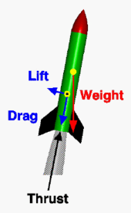
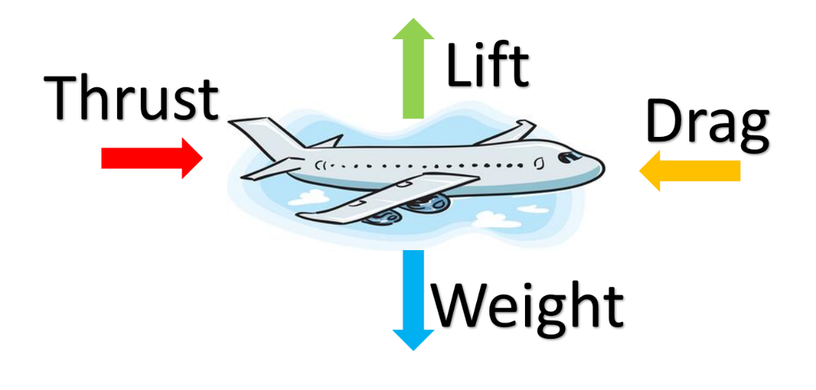
Four Forces of Flight
The Four Forces of flight also apply to a rocket
Rocket Image Source: https://spaceflightsystems.grc.nasa.gov/education/rocket/rktfor.html
Notes:
Lets recap on the four forces of flight. Lift, weight, drag, thrust.
Help students recognise the difference in the way the forces apply to rockets and planes.
On an aeroplane, LIFT opposes the WEIGHT of the plane.
On a rocket, THRUST opposes the WEIGHT of the rocket, and LIFT helps to stabilise and stop the rocket from spinning.
Although the same four forces act on a rocket as on an aeroplane, there are some important differences in the application of the forces:
1. On an aeroplane, the lift force is used to overcome the weight. On a rocket, thrust is used in opposition to weight. On many rockets, lift is used to stabilise and control the direction of flight.
2. On an aeroplane, most of the aerodynamic forces are generated by the wings and the tail surfaces. For a rocket, the aerodynamic forces are generated by the fins, nose cone, and body tube. For both aeroplane and rocket, the aerodynamic forces act through the centre of pressure (the yellow dot with the black centre on the rocket figure) while the weight acts through the centre of gravity (the yellow dot on the rocket figure).
3. While most aeroplanes have a high lift to drag ratio, the drag of a rocket is usually much greater than the lift.
4. While the magnitude and direction of the forces remain fairly constant for an aeroplane, the magnitude and direction of the forces acting on a rocket change dramatically during a typical flight.
https://spaceflightsystems.grc.nasa.gov/education/rocket/rktfor.html

Slide 5
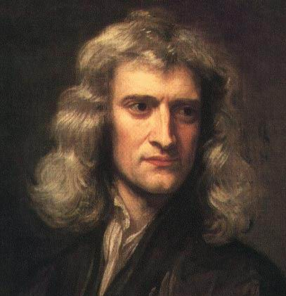
Newton’s Laws of Motion
Isaac Newton (1642-1727)
Newton’s laws explain how forces act on objects!
When a force acts on an object that is free to move, the object will move in accordance with Newton’s three laws of motion.
Image Source: http://www.sciencekids.co.nz/pictures/scientists/isaacnewton.html
Notes:
To help us understand the science / physics behind a rocket launch, we need to look at Newton’s Laws of Motion.
Sir Isaac Newton, a physicist and mathematician, published his three laws of motion in 1687.
Newton’s Laws are a vital foundation for learning and understanding more complex physics!
We looked closely at once of the three laws of motion in the previous session (Module 1.1) – does anybody remember which one? It was Newton’s 3rd Law! “Every action has an equal and opposite reaction.”
We can do some experiments to explore Newton’s Laws of Motion, to help us design our rockets!
Extension:
Newton explained that when the forces acting on an object are balanced, there is no change in the way it moves.
When the forces are unbalanced, there is an overall force in one direction, which alters the object’s speed or the direction in which it is moving.
Newton also emphasised the complicated relationship between objects and forces, which is due mainly to the effects of friction and air resistance. Without these forces, he concluded, the motions of objects are much simpler. So, his laws apply most obviously to bodies in space, such as planets and spacecraft, as there is no air or friction in space.

Slide 6
Newton’s 1st Law:
Any object will continue to remain stationary, or move in a straight line at a constant speed, unless an external force acts on it.
Objects like to keep doing what they are doing, unless an outside force affects them!
Image Source: https://pixabay.com/
Notes:
This is also called - The Law of Inertia
Ask students to think about how this law might relate to some everyday situations.
Examples:
1. Think about a football on a field. The football is stationary until it is kicked, then it moves, until another force brings it to a halt.
2. Think about when a car brakes suddenly, and objects that are unrestrained in the car keep moving, flying forward. This is because the object’s want to keep moving forward, in the same way they had been before the car slowed down.
Let’s do an experiment to observe Newton’s 1st Law!

Slide 7
Egg Drop
Aim: To observe Newton’s Laws of Motion
Equipment: (per group)
1 egg (or golf ball)
1 toilet roll
1 chopping board or 1 piece of thick cardboard
1 cup, partially filled with water
Procedure:
Form into groups of 3 to 4 students.
In groups:
Fill the cup (up to 3 quarters full) with water.
Place the board on top of the cup.
Place the egg (or ball) on top of the toilet roll (length ways), and then place the toilet roll and egg on top of the board.
Ensure the toilet roll and egg are lined up directly above the cup.
Swiftly pull the board out from under the toilet roll.
Observe where the egg (or ball) lands!
Notes:
This experiment highlights The Law of Inertia – Newton’s 1st Law.
Encourage students use the scientific method, and form a hypothesis, prior to conducting the experiment. Encourage students to share and discuss their observations and results.
Refer to RISK ASSESSMENT for Module 1 before conducting experiment.
Refer to Experiment notes (E1.2.1 in Coordinator Notes for Module 1.2)
This experiment should be performed on a surface which can get wet. Ensure paper towel / towels are available to clean up spills.
Be aware of potential allergies. Eggs can be removed from the experiment, and replaced with golf balls (or similar).
Extension: Repeat the experiment with 2 cups side by side and (2 eggs, 2 toilet rolls). Place the chopping board over both cups. See if you can get both eggs in the cups.

Slide 8
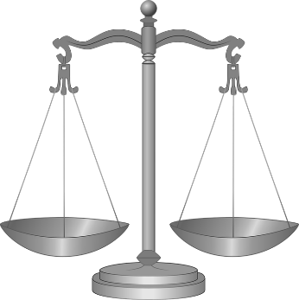
Newton’s 2nd Law:
When a force acts on an object, it will tend to move in the direction of the force.
The larger the force on an object, the greater it’s acceleration will be.
The more massive an object is, the greater the force needed to accelerate it!
Force = Mass x Acceleration
Notes:
Heavier objects need more force to accelerate them than light objects. Ask students to think about how this law might relate to some everyday situations.
Examples:
1.Think about how much force you need to use to kick a soccer ball compared to how much force you would need to kick a bowling ball. To get both balls to accelerate the same amount, you would need to put in more force for the bowling ball. (But we wouldn’t kick a bowling ball, as we know this would hurt our foot!)
2.Think about how easily you can lift an empty (light) school bag, compared to lifting up a very full (heavy) school bag.
Let’s do an experiment to observe Newton’s 2nd Law!

Slide 9
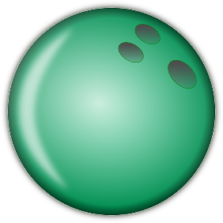
Accelerating Balls
Aim: To observe Newton’s Laws of Motion
Equipment: (per group)
1 x heavy ball (e.g. golf ball, pool ball or marble)
1 x light ball (e.g. ping pong ball, cotton ball)
Procedure:
Form into groups of 2 to 3 students.
In groups:
Place the light ball on a table, and push it carefully across the table.
Have a group member count how long it takes the light ball to get to the other side of the table. Record the result.
Place the heavy ball on the same table.
Push the heavy ball carefully across the table, using the same amount of force as you used for the light ball.
Have a group member count how long it takes the heavy ball to get to the other side of the table. Record the result.
Compare the time it took for each ball to travel to the other side of the table.
Notes:
This experiment highlights Newton’s 2nd Law.
Encourage students use the scientific method, and form a hypothesis, prior to conducting the experiment. Encourage students to share and discuss their observations and results.
Refer to RISK ASSESSMENT for Module 1 before conducting experiment.
Refer to Experiment notes (E1.2.2 in Coordinator Notes for Module 1.2)

Slide 10
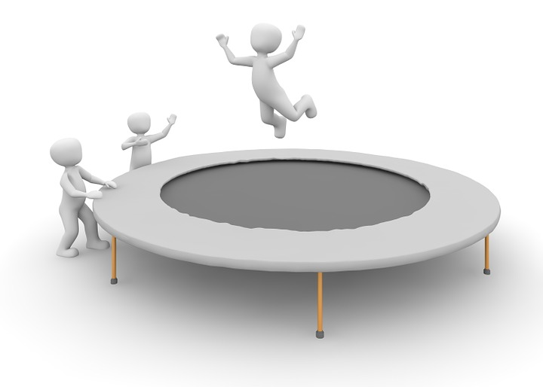
Newton’s 3rd Law:
Every action has an equal and opposite reaction!
Notes:
Newton’s 3rd Law of motion was introduced in Module 1.1.
Ask students what they know / remember about this law of motion.
Ask students to think about how this law might relate to some everyday situations.
Example:
Think about bouncing a ball. When you throw a ball downwards, it hits the ground and then bounces back up. The bounce back up is the equal and opposite reaction to you throwing the ball!

Slide 11
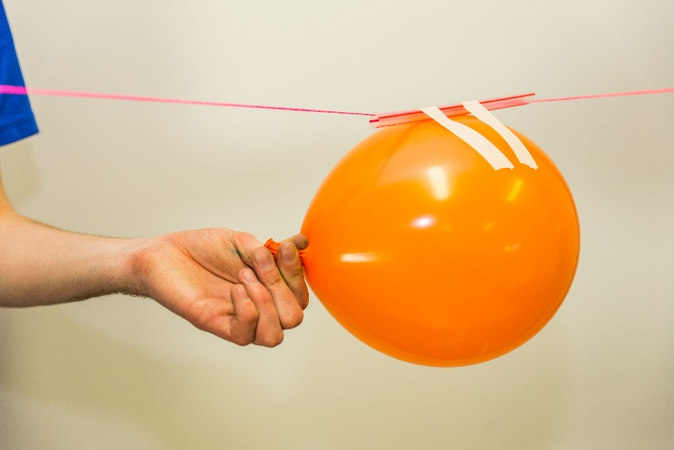
Balloon Rockets
Aim: To observe the effect of a sudden release of air on a balloon.
Equipment: (as a group)
Balloons
Tape (masking tape)
String
Straws
Procedure:
Measure out enough string to span between the walls of the room (create 1 to 3 stringlines).
Thread a short straw onto each string line.
Set up the stringline(s) by taping either end of the string to opposite walls of the room using masking tape.
Inflate a balloon but don’t tie it closed. Pinch the end of the balloon closed by hand.
Tape the middle of the inflated balloon onto the straw threaded onto the stringline.
Ensure the stringline is secured to the wall at each end.
Count down (3, 2,1) and release the balloon.
Observe the effect on the balloon. Document your observations!
Notes:
This experiment highlights Newton’s 3rd Law.
This law is the key in how rockets work!
Refer to RISK ASSESSMENT for Module 1 before conducting experiment.
Refer to Experiment notes (E1.2.3 in Coordinator Notes for Module 1.2)
Encourage students use the scientific method, and form a hypothesis, prior to conducting the experiment. Encourage students to share and discuss their observations and results.
Discuss the results with the students. Highlight the air pushing out of the balloon creating thrust, and pushing the balloon in the opposite direction.

Slide 12
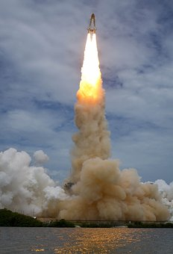
How do rockets generate thrust?
Image Sources: https://pixabay.com/
https://spaceflightsystems.grc.nasa.gov/education/rocket/rktfor.html
Notes:
Ask students how they think rockets generate thrust.
Rockets can be propelled in lots of different ways!
Space rockets are often fuelled with liquid oxygen and liquid hydrogen which burn very hot and give off hot gases.
Ask students how they think we make a model rocket launch?
We can make model rockets using lots of different things, including:
Air (like the balloon rockets)
Air and water
Chemical reactions
Let’s have a look at rocket powered by a chemical reaction…

Slide 13
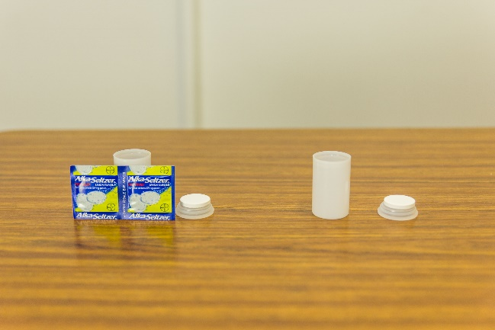
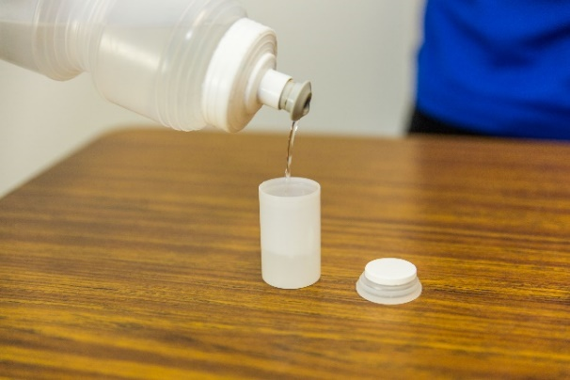
Alka-Seltzer Rocket
Aim: To observe the effect of pressure on a film canister.
Equipment: (For coordinator to demonstrate)
1 to 3 x film canisters
3-6 x Alka-Seltzer tablets
Bottle of water
Paper towel for cleaning up
Procedure:
Ensure canister lids are dry, then place half a tablet of Alka-Seltzer (broken into 2 or more pieces) onto each lid.
Fill one canister approximately 1/3 full with water.
Drop the Alka-Seltzer pieces into the water-filled canister, quickly place the lid on (you should hear a click). Quickly turn the canister over and put it down on the table (lid side down) and walk briskly away (at least 1 metre).
Stand back and observe the reaction!
Notes:
Refer to RISK ASSESSMENT for Module 1 before conducting experiment.
Refer to Experiment notes (E1.2.4 in Coordinator Notes for Module 1.2)
This experiment should be performed on a surface which can get wet. Ensure paper towel / towels are available to clean up spills.
Be aware of potential allergies to Alka-Seltzer.
Ensure all students are observing from a minimum of 1 metre away.
Ask students to form a hypothesis about what might happen if pressure builds up inside the canister, before conducting the experiment.
Discuss the result with the students after the experiment. Was their hypothesis correct?
Ask students to think about which law of motion the experiment relates to.
This experiment again highlights Newton’s 3rd Law. This is a good representation of how most rockets work!

Slide 14
What is Alka-Seltzer?
Alka-Seltzer is an ‘antacid’ tablet. It helps to neutralise the acid in your stomach to relieve conditions like heartburn.
They are made of chemicals: aspirin, baking soda (sodium bicarbonate) and citric acid.
When mixed with water, the chemicals in Alka-Seltzer react to form carbon dioxide gas, and water.
Notes:
Air Pressure:
When air gets squashed up in a small space, it builds pressure.
Some chemical reactions, like the Alka-Seltzer reaction, produce a gas. If the reaction is in a small space, all the gas being produced starts to build up, creating a lot of pressure.
Let’s have a go at building out own rockets!

Slide 15
Bottle Rocket Challenge
The Challenge:
Build a water and air fuelled rocket out of a plastic bottle, and some other small items!
We will test, and record:
How far the rockets can travel!
Notes:
Let’s have a go at building out own rockets! We will fuel our rockets with air and water, and create thrust using pressure.
Did you know there competitions, and world records for bottle rockets?
In Australia, the Institute of Industrial Arts Technology Education hosts an annual water bottle rocket competition for school students, called the Australian Aeronautical Velocity Challenge
http://iiate.asn.au/events/aeronautical-velocity-challenge
There are a number of companies that make and sell bottle rocket launchers. Lets take a look at a short video from one of these companies, “Liquifly”, to see what a bottle rocket looks like!

Slide 16
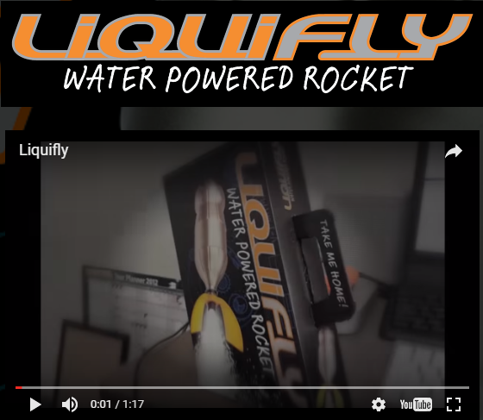
http://liquifly.com.au/
“Liquifly” water powered bottle rocket demonstration
Notes:
“Liquifly” works on the same principles as other rockets, with the energy coming from water and air. The action of pumping air into the bottle filled with water creates high pressure, which forces the water through the restricted opening at high velocity. This creates the thrust needed to launch the bottle high into the air.

Slide 17
World Record to beat…
The highest recorded flight by a water rocket is 830 metres!
The record is held by Ascension III, a water rocket designed and built by the University of Cape Town's INCFD group led by Prof Arnaud Malan and project leader Stuart Swan.
They were assisted by group members Donovan Changfoot and William Liw.
On 26 August 2015 the rocket reached an altitude of 835m in its first flight while powered only by water and compressed air. Taking the average of a second flight of 825m meant that a new Water Rocket World Altitude Record had been set at 830m.
This is a massive 33% more than the previous record of 623m which stood for 8 years.
Source: The Water Rocket Achievement World Record Association http://www.wra2.org/index.php
Notes:
In Australia, the Institute of Industrial Arts Technology Education hosts an annual water bottle rocket competition for school students, called the Australian Aeronautical Velocity Challenge
http://iiate.asn.au/events/aeronautical-velocity-challenge

Slide 18
Bottle Rocket Challenge Rules
The bottle rocket must only be fuelled with water and pressurised air from a bike or foot pump.
The rocket launch pad must be in a large open space outdoors. It will be set up at an angle of approximately 45 ° so rockets can be scored on horizontal distance travelled.
Distance measurements will be taken from the front of the launch pad to the middle of the rocket (where it lands).
The best distance out of your three official attempts will be your final score.
No rocket launch will take place until everyone is standing behind the launch pad, out of the rocket’s path.
All rocket launches must be supervised by the coordinator.
Notes:
Students may like to work individually or in groups.
Encourage them to name their rocket / team!
Rocket decoration is permitted!

Slide 19
Design Your Rocket!
Bottle rockets are to be made from plastic soft-drink bottles.
Other materials may be used to improve the aerodynamics of the rocket. Think about the forces of flight!
Water must be filled into the bottle and used as the fuel. How much you water use can make a big difference to performance!
Air will be pumped through the launcher into the bottle until it is pressurised.
The pressurised air will force the water out of the bottle when released, propelling it into the air.

Slide 20
References
NASA SpaceX rocket launch: https://www.nasa.gov/multimedia/videogallery/index.html
Aerodynamics of Rockets: https://spaceflightsystems.grc.nasa.gov/education/rocket/rktfor.html
Newton’s Laws of Motion & the Forces of Flight: https://www.britannica.com/science/Newtons-laws-of-motion https://www.grc.nasa.gov/www/k-12/UEET/StudentSite/dynamicsofflight.html#lawofmotion
Bottle Rocket Launch Video: http://liquifly.com.au/ or https://youtu.be/P3Lwjx19hZw
Bottle Rocket Design ideas: http://www.rokit.com/rokit-labs/water-rocket-experiments/
Australian Aeronautical Velocity Challenge: http://iiate.asn.au/events/aeronautical-velocity-challenge
The Water Rocket Achievement World Record Association: http://www.wra2.org/index.php

