Slide 1
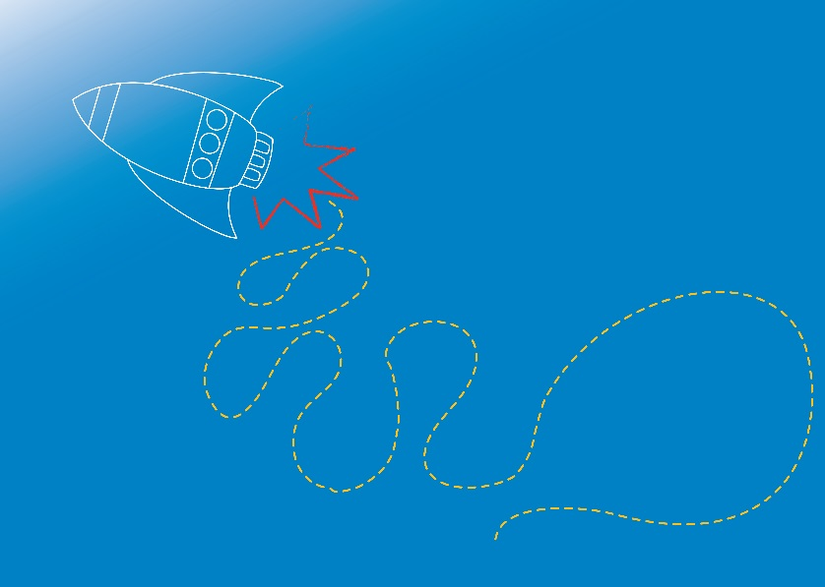


AIR & FLIGHT
Aerodynamics
Module 1.1

Slide 2

Welcome!
Hello! Great to meet you!
This is going
to be fun!
Image Source: http://www.pixabay.com
Notes:
Welcome to the first session of the Illumin8 Science Club!
We’re going to have so much fun and do some really cool experiments, all while exploring the world through science!
Lets start by meeting and getting to know each other!
See if you can find 2 people in the room that you don’t already know and introduce yourself!

Slide 3

What do we already
know about AIR?
Notes:
What do we know about air?
Encourage students to share what they already know!
Ask students what words they think of when they think about air?
Perhaps: hot air, air pressure, wind, gas?
Maybe flight, aerodynamics?
Ask students when they have noticed the air around them?
Perhaps on windy days, blowing up balloons, blowing out candles, running fast?

Slide 4

Make Observations
The Scientific Method
Ask a Question
Make a
Hypothesis
Conduct an
Experiment
Analyse your
Results
Make a
Conclusion
Hypothesis
Accepted
Hypothesis
Rejected
Communicate
your results
(This may become a new theory!)
Image Source: http://www.pixabay.com
Notes:
These are the steps every scientist uses to learn about the world.
When a scientist sees something they don’t understand, they form a question about it.
They’ll do some research to see what is already known about it and make an educated guess (a hypothesis) about the possible answer to their question.
They’ll then design and construct an experiment to test their hypothesis. Scientists will usually perform their experiment multiple times, and collect and analyse their results to form a conclusion.
If the results confirm their hypothesis, they can accept their hypothesis and communicate their results to the world. They may even propose a new theory according to their hypothesis.
If the results disprove the hypothesis, the scientist must go back and make a new hypothesis and test it again, and try again to find the answer to their question.

Slide 5
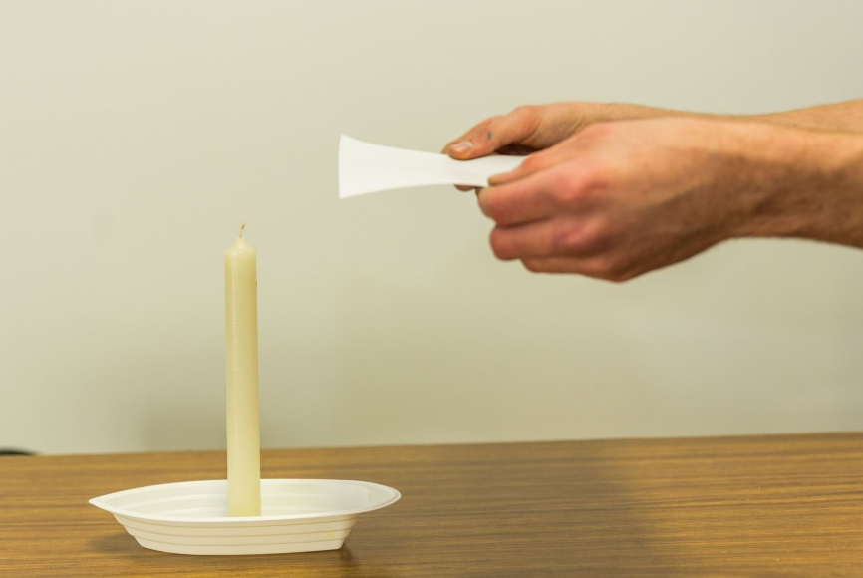
Moving Flame
Aim: To observe how air movement can affect a flame
Equipment (per group):
1 sheet A4 paper
1 candle
Matches (to light candle)
Procedure:
Form group of 3 to 4 students.
Collect a candle, paper and matches.
Place the candle on a table and light it (wait for supervisor!)
Gripping a piece of A4 paper at the two short ends, hold it beside and about twice the height of the candle.
Pull the paper abruptly downwards next to the candle.
Observe the effect on the flame.
Paper
Candle
Notes:
Lets take a look at a quick experiment to observe Air!
Before performing the experiment, reinforce the Scientific Method by discussing with the students a hypothesis about what might happen e.g. the flame will move towards/away from the paper.
Then assist students to perform the experiment to confirm or disprove the hypothesis.
Discuss what was observed (the results), and explore student ideas on why this may have happened.
Briefly explain the flame moves towards the paper, due to air pressure.
The air underneath the paper moves at a high speed when the paper is pulled downwards, causing low pressure. The pressure remains unchanged on the other sides of the candle flame. Air moves from high pressure, to low pressure.
Refer to RISK ASSESSMENT for Module 1 before conducting experiment.
Refer to Experiment notes (E1.1.2 in Coordinator Notes for Module 1.1)

Slide 6
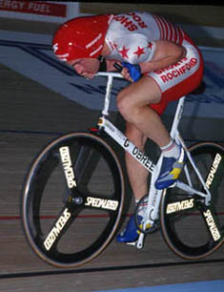
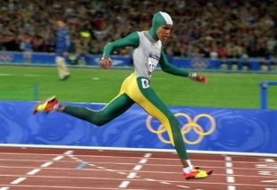
Ever wondered why…
athletes wear special clothing?
Image Source: http://www.danielyeow.com/2014/sochi-special-speed-suits/#fancybox/2/
Notes:
Ask students their ideas.
Prompt students to think about wind resistance.

Slide 7
Aerodynamic shapes
Image Source: http://www.danielyeow.com/2014/sochi-special-speed-suits/#fancybox/2/
Notes:
Athletes have specially designed clothing, equipment and uniforms which help them move through the air smoothly – reducing wind resistance.
Ask the students to think of other places where specialised uniforms or equipment are used?
Why do they think it is important in each case?
Aerodynamics is the science of how air moves around things.
It helps us to understand why different shapes move through the air differently.
Without an understanding of aerodynamics we wouldn’t have planes, space rockets, fast trains and many other useful inventions.

Slide 8
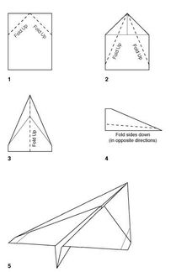
Aerodynamic Test
Aim: To observe the effect of aerodynamic shapes
Equipment:
A4 paper - 2 sheets per student
Procedure:
Fold one piece of A4 paper into a paper plane,
using the instructions provided.
Throw both the unfolded and folded pieces of
paper (wait for supervisor to say go!)
Observe how both objects travel through the air. Document your observations!
Discuss your ideas on why they behaved differently
Notes:
Lets take a look at a quick experiment to observe aerodynamics!
Reinforce the Scientific Method by discussing with the students a hypothesis about what might happen.
Then assist students to perform the experiment to confirm or disprove the hypothesis.
Discuss what was observed (the results), and explore student ideas on why this may have happened.
The paper planes fly further than unfolded paper, due to their more aerodynamic shape.
The planes have a pointed nose to cut through the air well, and wings for lift.
Refer to RISK ASSESSMENT for Module 1 before conducting experiment.
Refer to Experiment notes (E1.1.3 in Coordinator Notes for Module 1.1)

Slide 9
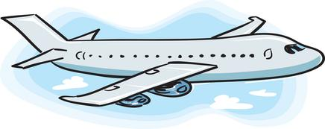
Four Forces of Flight
Lift
Thrust
Drag
Weight
Notes:
Weight – the downward pull of gravity on an object.
Lift – the upward force which works against gravity. The air moving around the wings on a plane give the plane its lift.
Thrust – the propulsion of the object forward. In a plane this force could come from a propeller or jet engine.
Drag – the backward force of the air pushing against the object. This is opposite to thrust. You can feel this when you put your hand out of a car window!
If two forces acting against each other are not equal, the plane will change course.
For example, if weight force is greater than lift force, the plane will fall.
If drag force is greater than thrust force, the plane will travel backwards!

Slide 10
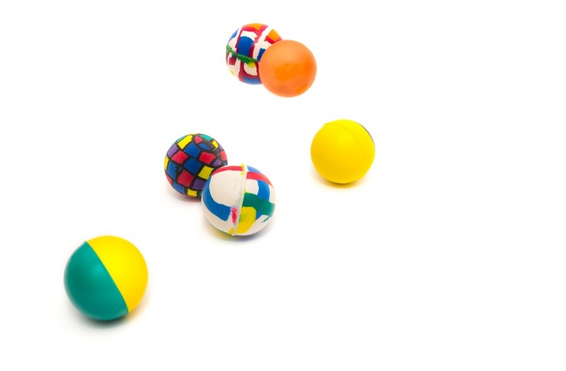
Newton’s 3rd Law of Motion
Every action has an equal
and opposite reaction!
Image Source: http://www.pixabay.com
Notes:
Think of when you bounce a ball. When you throw a ball downwards, it hits the ground and then bounces back up.
The bounce back up is the equal and opposite reaction to you throwing the ball!
Think about how high a ball will bounce if you throw it to the ground with high force, compared to low force?
We will learn more about Sir Isaac Newton and his 3 laws of motion in future sessions! He was a very famous physicist.
Newtons first law: every object will remain at rest or in uniform motion in a straight line unless compelled to change its state by the action of an external force.
Newtons second law: explains how the velocity of an object changes when it is subjected to an external force. The law defines a force to be equal to change in momentum (mass times velocity) per change in time. For an object with a constant mass m, the second law states that the force F is the product of an object's mass and its acceleration a: F = m * a

Slide 11
How does lift work?
When air moves over the top of a plane wing,
something unexpected happens…
As the plane moves forward, air travels more quickly over the top of the wing.
Air Flow
Wing
Newtons 3rd Law:
Every action has an equal and opposite reaction.
Notes:
The air that travels over the top of a plan wing is dragged downwards rapidly over the wing by the Coanda effect.
Since the plane has pulled air downwards, an equal and opposite reaction acts upon the plane and pushes the plane up, according to Newtons 3rd law!
Coanda Effect: A moving stream of fluid in contact with a curved surface will tend to follow the curvature of the surface rather than continue traveling in a straight line. To perform a simple demonstration of the Coanda effect, you can use a spoon and a tap. Turn on a tap to allow a slow stream of water to flow, then hold a spoon vertically, and place the bottom of the spoon (curved part) next to the water stream. Notice how the water curves along the surface of the spoon.
Air Pressure: In an aeroplane wing, the top surface of the wing often has a longer curve (more camber) than the bottom surface, so the air flows faster over the top of the wing than it does underneath. This results in lower air pressure above the wing, than below. This difference in air pressure also contributes to lift.

Slide 12

Paper Lift
Aim: To observe how air movement can affect a piece of paper
Equipment:
A4 paper (1 per student)
Procedure:
Collect a piece of A4 paper.
Hold the short edge of the paper just under your
bottom lip with the long end hanging down in front of your chest.
Take a big breath
Blow as hard as you can out of your mouth.
Observe the effect on the paper
Extension: observe how the effect changes if you blow harder or softer.
Paper
Notes:
Lets test it out!
Don’t forget the scientific method!
Observation – Big, heavy planes can fly
Ask a question – how are they able to stay in the air?
Make a hypothesis (prediction) – they can stay in the air due air being pushed downwards and Newtons 3rd law!
Test your hypothesis by doing an experiment – blowing above a piece of paper
Analyse results – what happened in the experiment, what may this mean?
Make a conclusion – was your hypothesis correct?
Communicate your findings – report your theory of how wings generate lift
Refer to RISK ASSESSMENT for Module 1 before conducting experiment.
Refer to Experiment notes (E1.1.1 in Coordinator Notes for Module 1.1)

Slide 13

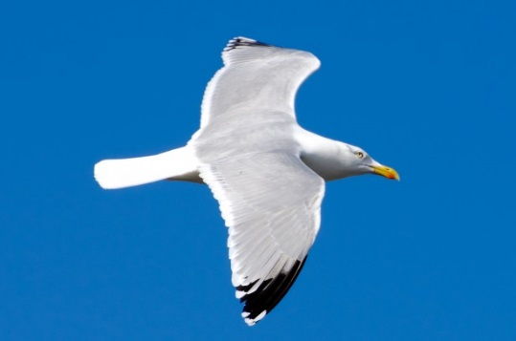
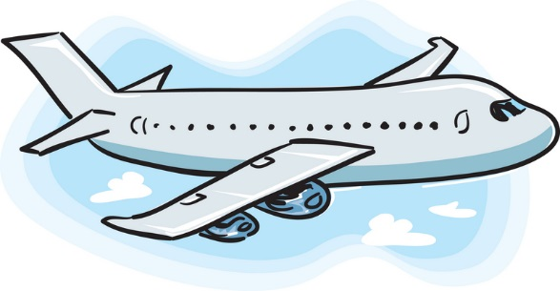
What do these have in common?
Notes:
This exercise should highlight the important features of objects of flight.
Ask students to take a look at the three objects and suggest what they do, and don’t, have in common.
This will help students to think about their paper plane design for the challenge activity.
Commonalities: Aerodynamic shapes, pointed tips, tails.
Note: Rockets don’t have wings! Why don’t they need wings?
Where do rockets go? Space. What ISN’T there in space? AIR.
Wings give birds and aeroplanes LIFT because of the way they interact with the AIR.
Rocket wings would be pointless because rockets do not need the air to lift them up.
Instead, the burning of rocket fuel creates high-speed exhaust gases – this is what propels the rocket.

Slide 14
Paper Aeroplane Challenge!

Slide 15
Paper Aeroplane Challenge:
Build a paper aeroplane out of a
single piece of A4 paper!
We will test, and record:
Distance plane travels before hitting the ground
Amount of time plane spends in the air
Notes:
Did you know there are world championship competitions, and world records for paper aeroplanes?
Lets take a look at a short video from the “Paper Airplane World Championship” - Red Bull Paper Wings 2015

Slide 16
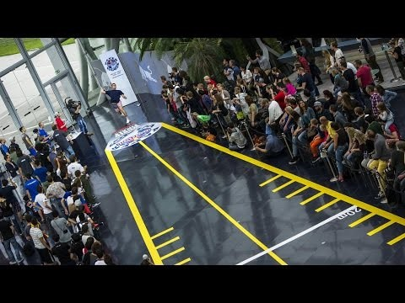
https://www.youtube.com/watch?v=SUyqakRMrxo
Paper Airplane World Championship - Red Bull Paper Wings 2015

Slide 17
World Records to beat…
The farthest flight by a paper aircraft is 69.14 metres!
Achieved by Joe Ayoob and aircraft designer John M. Collins (both USA) on 26 February 2012. The plane was constructed from a single sheet of uncut A4 paper. Joe Ayoob flew the aircraft designed by John M. Collins.
The longest time flying a paper aircraft is 29.2 seconds!
Achieved by Takuo Toda (Japan), in Fukuyama City, Hiroshima, Japan, on 19 December 2010.
http://www.guinnessworldrecords.com/world-records/farthest-flight-by-a-paper-aircraft
http://www.guinnessworldrecords.com/world-records/longest-time-flying-a-paper-aircraft

Slide 18
Aeroplane Challenge Rules
Paper planes must be made out of a single piece of A4 paper
(it may be cut with scissors).
Paper clips may be used as weights if desired.
Paper plane thrower must stand behind starting line.
Distance measure will be taken from starting line to nose of the
plane when landed.
Time aloft measurement is timed from the moment the plane leaves
the throwers hand to the moment any part of the plane touches the ground or other object.
Thrower is given a maximum of three attempts. The best attempt will
be taken as the score.
Participants can construct a single plane for both tests OR two separate planes, one dedicated to each test. A maximum of two planes will be
used in testing for each participant / group.
Final point score will be the best distance plus the best time for each participant / group.
Notes:
Students may like to work individually or in groups.
Encourage them to name their plan / team! Plane decoration is permitted!
Discuss with the students the need to make the paper into an aerodynamic shape.
Go through the pictures of the planes on the next slides, and point out the common features.
See if the students can come up with their own paper plane design. Alternatively they could search on the internet for different designs if internet access is available, or use one of the supplied instructions.
Useful web links for plane designs and instructions:
http://www.foldnfly.com
http://www.funpaperairplanes.com/plane_downloads-eu.html
http://www.origami-kids.com/
Refer to RISK ASSESSMENT for Module 1 before conducting challenge.
Refer to Coordinator Notes for Module 1.1 for tips and score sheets.

Slide 19
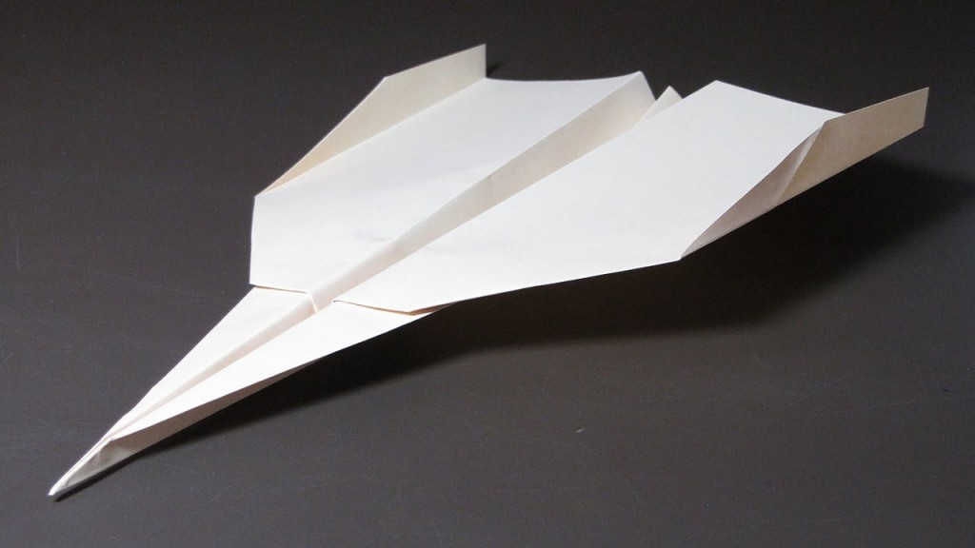

Slide 20
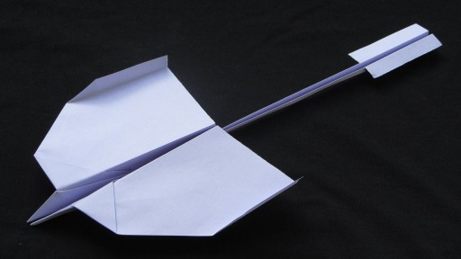

Slide 21
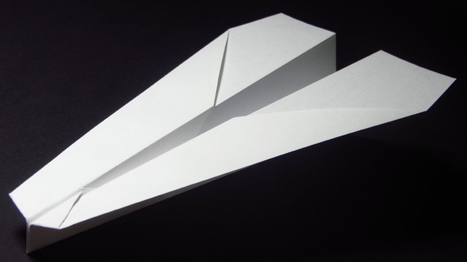

Slide 22
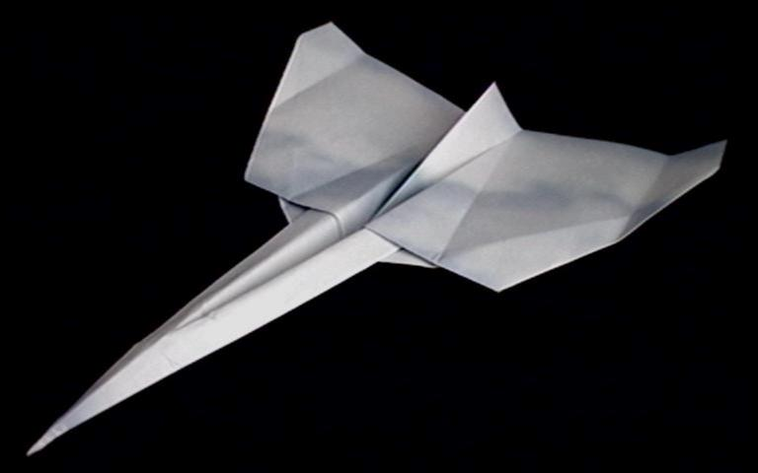

Slide 23
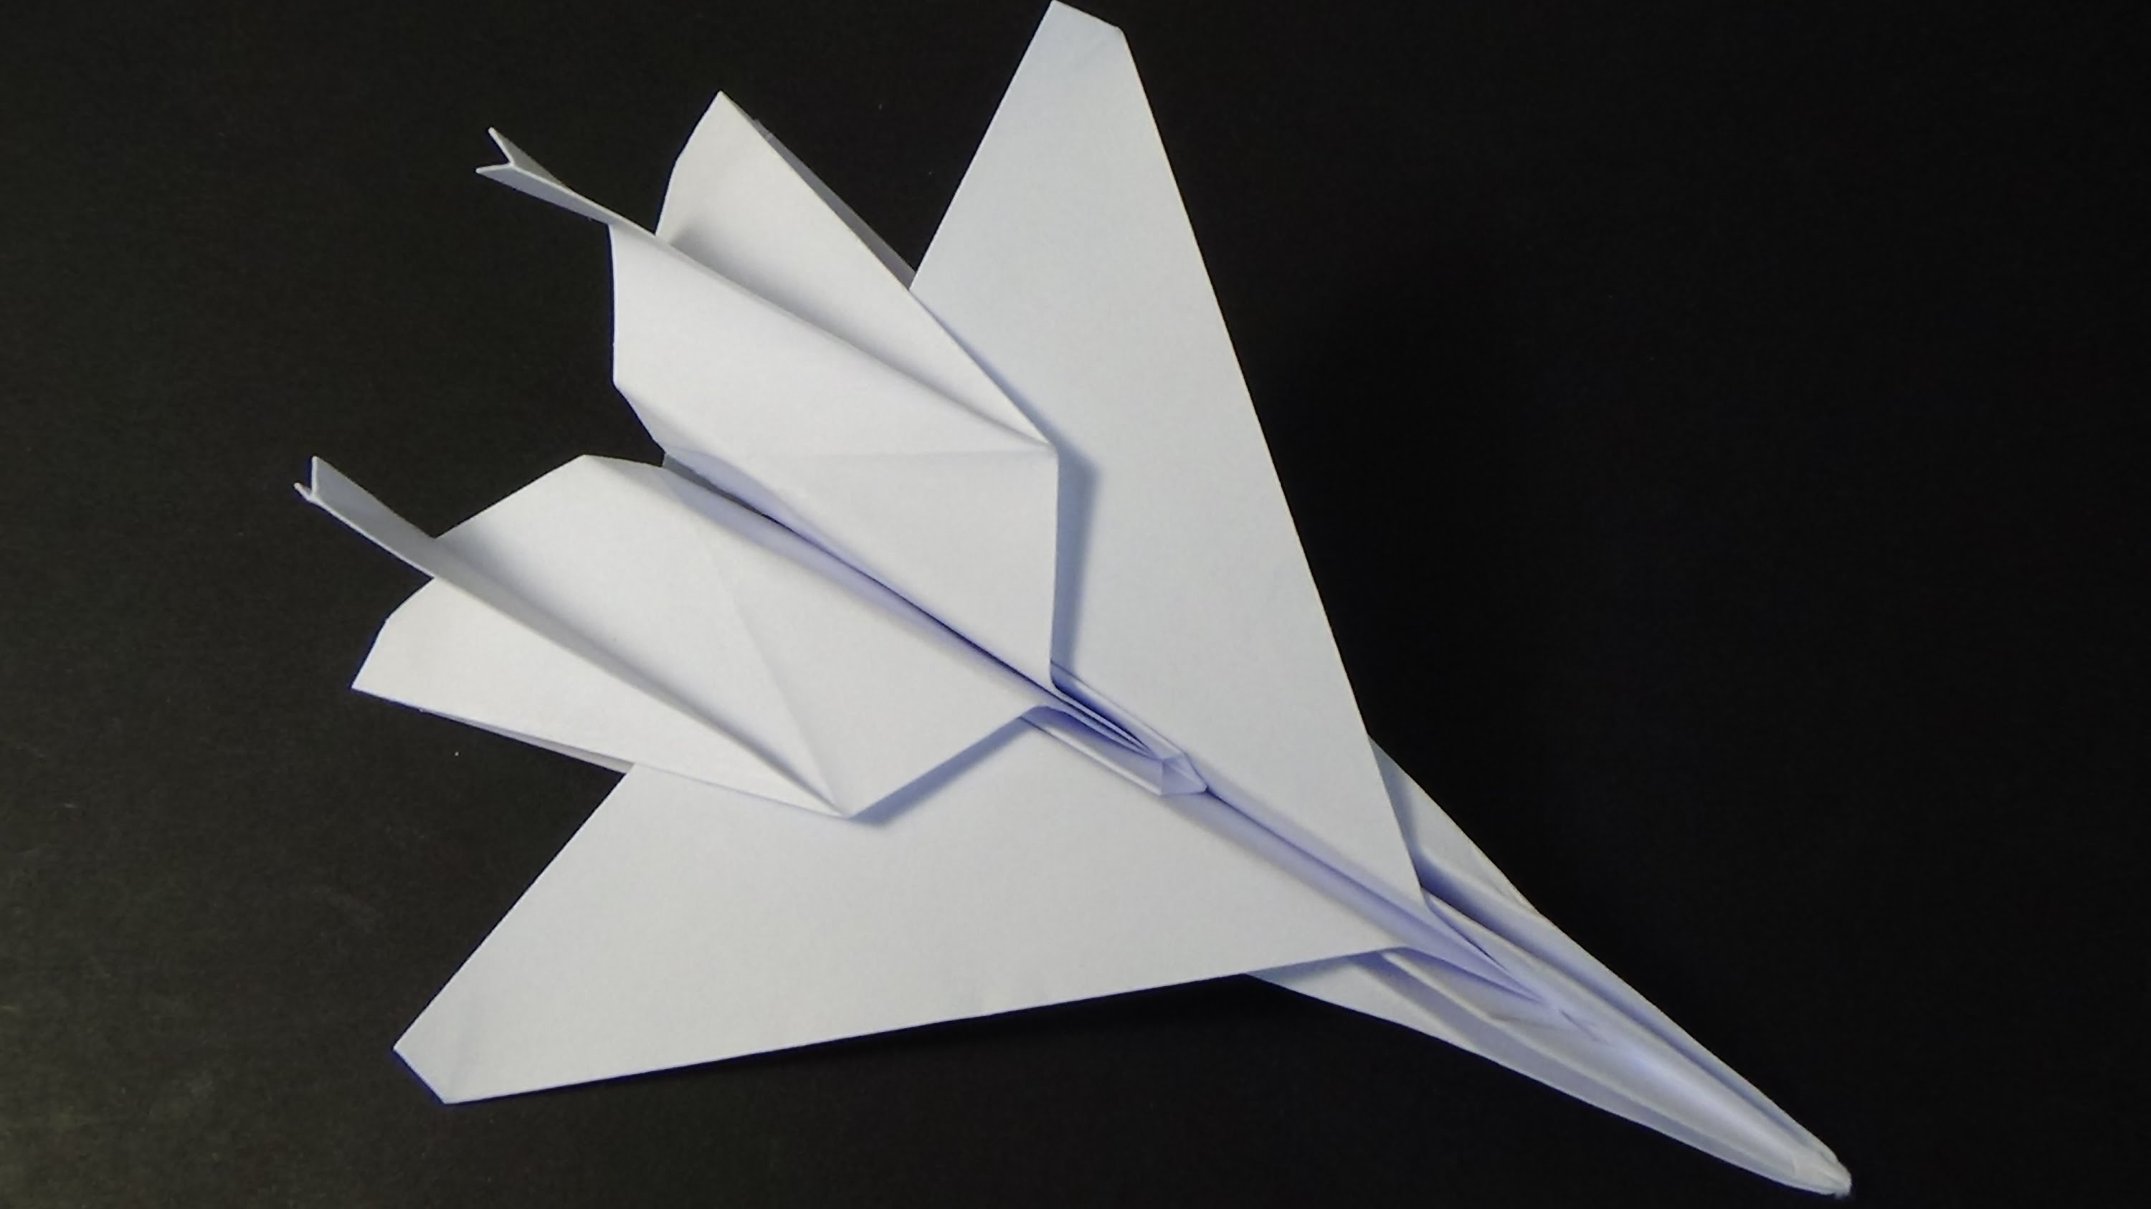

Slide 24
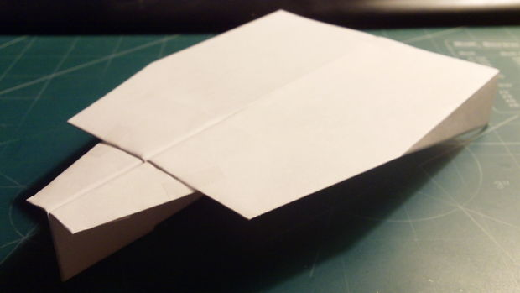

Slide 25
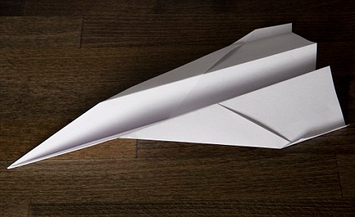

Slide 26
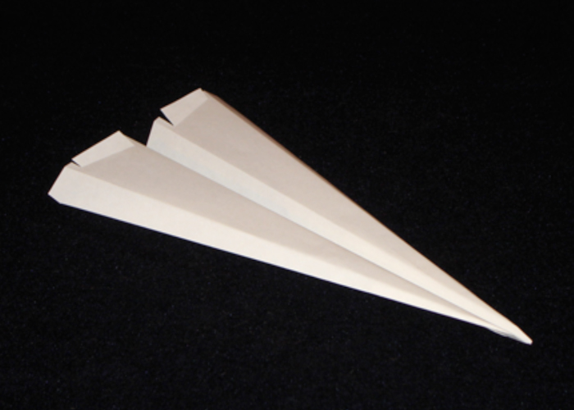

Slide 27
References
Plane designs:
http://www.funpaperairplanes.com/plane_downloads-eu.html
Paper Wings Competition Video:
https://www.youtube.com/watch?v=SUyqakRMrxo
Guinness World Records:
http://www.guinnessworldrecords.com/world-records/farthest-flight-by-a-paper-aircraft
http://www.guinnessworldrecords.com/world-records/longest-time-flying-a-paper-aircraft
Aerodynamics:
http://www.nasa.gov/audience/forstudents/5-8/features/nasa-knows/what-is-aerodynamics-58.html
http://www.aviation-for-kids.com/Lift.html
Scientific Method:
http://www.sciencemadesimple.com/scientific_method.html

Slide 28
Ever wondered why…
athletes wear special clothing?
Aerodynamic shapes
Image Source: http://www.danielyeow.com/2014/sochi-special-speed-suits/#fancybox/2/
Notes:
Ask students their ideas.
Prompt students to think about wind resistance.
Athletes have specially designed clothing, equipment and uniforms which help them move through the air smoothly – reducing wind resistance.
Ask the students to think of other places where specialised uniforms or equipment are used?
Why do they think it is important in each case?
Aerodynamics is the science of how air moves around things.
It helps us to understand why different shapes move through the air differently.
Without an understanding of aerodynamics we wouldn’t have planes, space rockets, fast trains and many other useful inventions.

